Slide 1
지능형 무선 액세스 기술 개발 : Semantic Communications
Preserving Semantic Integrity: AI-Driven Data Reconstruction for Enhanced Communication Systems
^{Azharul Islam}
^{Prof. KyungHi Chang}
2025. 05. 09
Mobile Telecommunications Research Lab
http://mobile.inha.ac.kr
INHA University, Department of Electronic Engineering

Slide 2
ToC
Introduction on the System [p. 3]
Semantic Communication
Why Domain Knowledge Matters?
System Architecture Overview
Significance and Applications
Our Contributions [p. 4]
Previous Proposed Architecture [p. 5]
Comparison with the Previous Architecture [p. 6]
Previous ETRI Comments and Improvements [p. 7]
Comparative Analysis of Text Semantic Communication with Contributions [p. 8]
Proposed DSKB based SC Text Reconstruction Architecture [p. 11]
Semantic vs Direct Communication System Architecture [p. 12]
Overall System Results Metrics [p. 13]
Overall System Performance Metrics with Comparison
Physical Channel Performance Analysis
Physical-Semantic Integration Performance
Semantic Channel Performance Analysis
Overall System Results Visualization [p. 22]
System Enhanced Evaluation Metrics
Knowledge Base Contribution Visualizations
Noise Robustness Evaluation Visualizations
Physical Channel Performance Visualizations
RL Agent Performance Visualizations
Semantic vs Direct Reconstruction
Appendix [p. 29]

Slide 3
Introduction on the System
System represents a significant advancement in how we handle communication in noisy channels by focusing on meaning preservation rather than just bit-level accuracy.
Semantic Communication
Semantic communication focuses on preserving the meaning of messages rather than exact bit-by-bit accuracy. Unlike traditional communication systems that aim to minimize bit errors, semantic communication prioritizes maintaining the essential meaning and contextual integrity of information.
Why Domain Knowledge Matters?
This system specifically focuses on parliamentary communications (using European Parliament data) for several reasons.
Specialized Vocabulary: Parliamentary proceedings contain unique terminology, names, and institutional references.
Structured Language Patterns: Parliamentary communication follows predictable patterns and formats.
Critical Content Integrity: Maintaining accuracy in parliamentary proceedings is essential for legal and historical records.
Domain knowledge allows the system to better understand what's "important" in a message and prioritize preserving these critical elements during transmission and reconstruction.
System Architecture Overview
Semantic Encoding: Converting text to semantic embeddings using BERT, enhanced with domain knowledge
Channel Encoding: Preparing data for transmission with content-adaptive protection
Physical Channel: Transmission through noisy wireless channels with realistic impairments
Channel Decoding: Recovering transmitted data with error correction
Semantic Decoding: Reconstructing original messages through multiple AI-powered methods
Significance and Applications
This work bridges traditional communication engineering with modern AI techniques, resulting in a system that:
Preserves meaning in challenging communication environments
Adaptively protects critical information and Makes intelligent resource allocation decisions
Demonstrates the value of domain knowledge in communication systems
Such semantic communication systems could revolutionize various fields including emergency communications, legal document transmission, medical data sharing, and any scenario where preserving meaning is more critical than exact wording.

Slide 4
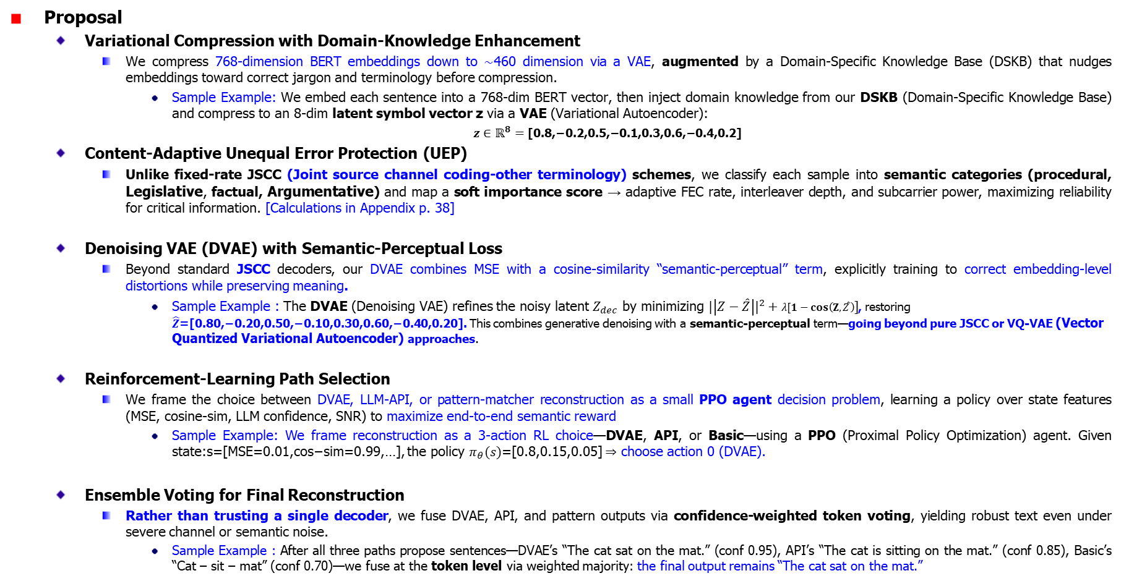
Our Contributions
Proposal
Variational Compression with Domain‐Knowledge Enhancement
We compress 768-dimension BERT embeddings down to ∼460 dimension via a VAE, augmented by a Domain-Specific Knowledge Base (DSKB) that nudges embeddings toward correct jargon and terminology before compression.
Sample Example: We embed each sentence into a 768-dim BERT vector, then inject domain knowledge from our DSKB (Domain-Specific Knowledge Base) and compress to an 8-dim latent symbol vector z via a VAE (Variational Autoencoder):
$z∈ℝ^{8}=\text{[0.8,−0.2,0.5,−0.1,0.3,0.6,−0.4,0.2]}$
Content-Adaptive Unequal Error Protection (UEP)
Unlike fixed‐rate JSCC (Joint source channel coding-other terminology) schemes, we classify each sample into semantic categories (procedural, Legislative, factual, Argumentative) and map a soft importance score → adaptive FEC rate, interleaver depth, and subcarrier power, maximizing reliability for critical information. [Calculations in Appendix p. 38]
Denoising VAE (DVAE) with Semantic-Perceptual Loss
Beyond standard JSCC decoders, our DVAE combines MSE with a cosine-similarity “semantic‐perceptual” term, explicitly training to correct embedding-level distortions while preserving meaning.
Sample Example : The DVAE (Denoising VAE) refines the noisy latent $Z_{dec}$​ by minimizing ${|\left|Z−\hat{Z}\right||}^{2}+λ[1−cos\left(Z,\hat{Z}\right)]$, restoring $\hat{Z}$=[0.80,−0.20,0.50,−0.10,0.30,0.60,−0.40,0.20]. This combines generative denoising with a semantic‐perceptual term—going beyond pure JSCC or VQ-VAE (Vector Quantized Variational Autoencoder) approaches.
Reinforcement-Learning Path Selection
We frame the choice between DVAE, LLM-API, or pattern-matcher reconstruction as a small PPO agent decision problem, learning a policy over state features (MSE, cosine-sim, LLM confidence, SNR) to maximize end-to-end semantic reward
Sample Example: We frame reconstruction as a 3-action RL choice—DVAE, API, or Basic—using a PPO (Proximal Policy Optimization) agent. Given state:s=[MSE=0.01,cos−sim=0.99,…], the policy $π_{θ}(s)$=[0.8,0.15,0.05] ⇒ choose action 0 (DVAE).
Ensemble Voting for Final Reconstruction
Rather than trusting a single decoder, we fuse DVAE, API, and pattern outputs via confidence-weighted token voting, yielding robust text even under severe channel or semantic noise.
Sample Example : After all three paths propose sentences—DVAE’s “The cat sat on the mat.” (conf 0.95), API’s “The cat is sitting on the mat.” (conf 0.85), Basic’s “Cat – sit – mat” (conf 0.70)—we fuse at the token level via weighted majority: the final output remains “The cat sat on the mat.”
Notes:
For 3 JSCC Approach: Instead of separate compression and channel coding, JSCC jointly learns a single encoder–decoder that maps source symbols (e.g. semantic embeddings) directly to channel inputs and back, often via deep autoencoders that simulate noisy channels during training. VQ-VAE
Introduces a learned discrete codebook: the encoder outputs index vectors that select entries from a finite embedding table, replacing continuous sampling with nearest‐neighbor “quantization,” then decodes back to the original space.

Slide 5
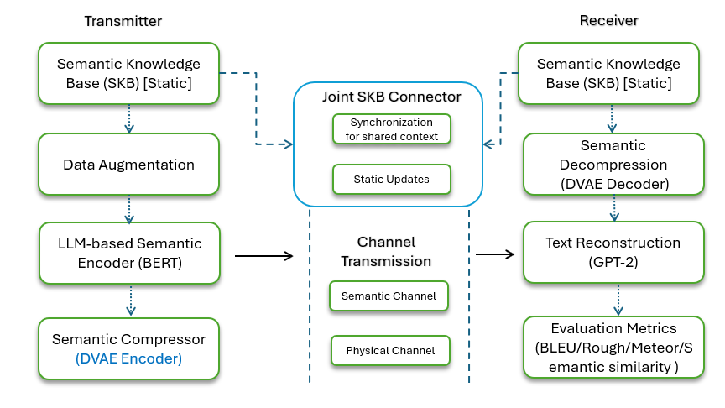
Previous Proposed Architecture
Proposed DSKB based SC Text Reconstruction Architecture [ OLD Architecture]

Slide 6
Comparison with the Previous Architecture
Nr. | Aspect | Previous Deck | Updated Deck | Remarks / Improvements
1 | Overall Architecture | High-level two-block diagram: "Semantic Encoder → Physical Channel → Semantic Decoder" with minimal detail on submodules. | Detailed multi-stage block diagram: – Semantic Encoder (BERT→KB→VAE) – Content-Adaptive Channel (classification → coding → OFDM) – Physical Layer (AWGN/Rayleigh/ freq-selective) – Channel decoder (Recovery with error) – Semantic Decoder (DVAE, API, pattern, RL+voting) | Makes dataflows explicit; clarifies where each noise/model sits.
2 | Knowledge-Base Integration | Mentioned "KB block" but without contents or sync mechanism. | Expanded DSKB contents: term dictionaries, context rules, phrase patterns, semantic relations; showed TX/RX KB update loop. | Highlights domain specificity; enables online updates (dynamically modified at runtime).
3 | Noise Modeling | Only Gaussian semantic noise briefly noted; physical channel abstracted as "noise." | Three semantic noise types: Literal (typos/word drops) Embedding-level (Gaussian jitter, dropout) Adversarial (gradient-based attacks) Plus, full physical channel model ( ex: OFDM channel with pilot-based estimation) | Provides richer, more realistic error scenarios.
4 | Content-Adaptive Coding | Single "Channel Encoder" block with no classification detail. | Showed EnhancedContentClassifier (factual vs. procedural), importance-weighting profiles, etc. | Improves UEP (Unequal error protection) and links semantic importance to PHY.
5 | Compression & Denoising | Listed "VAE" and "DVAE" but no hyperparameters or training flow. | Specified compressor dimension (768→∼460), KL/reconstruction loss; DVAE's semantic-perceptual loss; blockwise training order. | Clarifies training loops and loss functions.
6 | Channel Details | Generic "semantic channel" label; no Physical channel considerations. | Fully parameterizable semantic channel with physical channel: Channel Model: AWGN, flat‐fading, frequency‐selective, tapped‐delay; Path Loss & Shadowing: free‐space/log‐distance + log‐normal σ; Fading: Rayleigh/Rician (K‐factor) + Doppler (speed, fₙ max); Mobility: user speed → coherence time (e.g. 50 km/h); Coding & Modulation: UEP‐controlled FEC (½–7/8), any M-QAM/PSK; Interleaving: depth adjustable (e.g. 16–64); Estimation & Equalization: pilot‐based LS/MMSE or blind, ZF/MMSE; MIMO Support: Nt×Nr, spatial correlation; Simulation Controls: SNR sweep, Monte Carlo runs, random seed; Etc…. | Supports any channel scenario—AWGN to mobile MIMO fading—ensuring reproducible, real-time, cross-layer experiments.
7 | Training Strategy & Equations | High-level note "train VAE and DVAE" without schedule; equations scattered. | Blockwise training schedule: VAE (KL+MSE) DVAE (add semantic loss) Classifier RL agent (PPO objective) | Makes methodology transparent; eases peer review.
8 | Reconstruction Paths | Single "Semantic Decoder" box, hinted at LLM fallback. | Three parallel paths: DVAE denoising, LLM API (GPT-3.5/4) with CircuitBreaker, pattern-based matcher; RL agent + ensemble voting. | Boosts robustness via ensemble; shows decision logic.
Notes:
UEP stands for Unequal Error Protection. It’s a coding strategy whereby different parts of your bitstream receive different levels of forward‐error‐correction (FEC) strength based on their importance. In a nutshell:
Why UEP? In semantic communications, not all information is equally critical. A few key semantic features (e.g. technical terms, unit values) carry most of the meaning, while other “filler” dimensions can tolerate more errors without breaking overall understanding.
How it works:
Importance classification (via your EnhancedContentClassifier) tags each embedding dimension—or groups of bits after quantization—as high-, medium-, or low-priority.
Adaptive FEC rates are then assigned:
High-priority bits use a low code rate (e.g. ½), adding lots of parity and interleaving so they survive harsh channel conditions.
Medium-priority bits might use a moderate rate (e.g. ¾).
Low-priority bits can use a high rate (e.g. 7/8) or even be sent uncoded to save bandwidth.
Optionally, you can layer repetition, unequal interleaving depth, or even different modulation orders per stream (e.g. QPSK vs. 16-QAM).
In your framework: The ContentAdaptivePhysicalChannel module in content_adaptive_coding.py uses UEP to map semantic importance → coding parameters, ensuring your most meaningful latent dimensions get the strongest protection through the OFDM link.
Compressor dims (768→∼460): We use a VAE encoder to squeeze the 768-dim BERT embedding down to about 460 dimensions.
KL + Reconstruction loss: When training that VAE, we optimize LVAE (equation) so it both reconstructs faithfully and keeps the latent close to a normal prior.
DVAE’s semantic-perceptual loss: The denoising VAE (DVAE) learns to invert channel noise by minimizing equation by combining MSE with a cosine-similarity term that preserves meaning.
“KL” stands for the Kullback–Leibler divergence, a measure of how one probability distribution diverges from a second, reference distribution.
The RL Agent Decision is a selector—it looks at the state features (MSE, cosine‐sim, LLM confidence, pattern score, SNR) and chooses one path (DVAE vs. API vs. Basic) via its learned policy πθ\pi_\thetaπθ​.
The Ensemble Voting is a fuser—it takes the three path outputs you already generated, assigns each a confidence weight (e.g. DVAE’s cosine‐sim, API’s avg log-prob, pattern matcher’s match rate), and then combines them (via weighted voting or token-level fusion) into a single final reconstruction.
In short:
RL Agent → “Which single path should I trust this time?”
Ensemble Voting → “Given all three candidates, how do I best merge their strengths into one output?”
By fixing v=50 km/h, all of our physical‐layer parameters (pilot spacing, equalizer update rate, interleaver duration) get calibrated to a coherence time and Doppler spread that reflect a realistic mobile user—ensuring our end‐to‐end semantic pipeline is robust to the kinds of fading dynamics

Slide 7
Previous ETRI Comments and Improvements
Nr. | Comment | Revision | Status | Additional Consideration will be
1 | What does the semantic channel include? | “semantic channel” block to show both Gaussian & burst semantic-noise models and a full OFDM-based physical channel (AWGN, Rayleigh, freq-selective fading) | Done | -
2 | Does the semantic-noise model with Gaussian noise account for physical channel noise? | semantic noise is in addition to physical noise—added separate physical-layer block (pilot estimation, equalization) and cross-layer integration notes. | Done | Quantify joint semantic + physical SNR impact visualization [On going]
3 | Effect of differences between a semantic channel and a real channel? | Added side-by-side plots in updated work: semantic-only vs. semantic + physical channel performance (BLEU & semantic-similarity vs. SNR), highlighting divergence at low SNR. | Done | Show per-content-class sensitivity [On going]
4 | What are the sources of semantic errors? | literal (typos, word drops), embedding-level (Gaussian jitter, dropout), adversarial (gradient-based) — each with code-module pointers. | Done | Include real OCR (Optical Character Recognition), Character Error Rate (CER), Word Error Rate (WER) [On going]
5 | What is DSKB, and how does it reflect in the main diagram? | Detailed DSKB contents (term dictionary, context rules, phrase patterns) in semantic-encoder/decoder blocks, and showed TX/RX KB sync mechanism. | Done | Explore auto-updating KB via online learning [On going]
6 | Why is BERT used on the transmitter side? | BERT serves as the preprocessing step to convert raw text → 768-d embedding (for downstream compression), not as the final reconstruction model. | Done | Compare with domain-specific transformers (RoBERTa) [On going]
7 | What real-time channel model parameters/processes are missing? | SNR thresholds for adaptive modulation, pilot insertion rate, CP length, FEC code rates, interleaver depth, channel estimation (MMSE/ZF), mobility/Doppler assumptions etc… | Done | -
8 | Training process: end-to-end or block-by-block? Principal equations for each block? | specified blockwise training schedule (VAE → DVAE → classifier → RL agent), listed key loss functions (recon + KL, semantic-perceptual, PPO objective), and placed core equations on one summary slide. | Done | -
9 | Scalability & Complexity [Out-of-Scope] | Check real time implementation by Scalability & Complexity considerations. |  | Measure runtime, model size; propose pruning/distillation paths
10 | Multi-modal Input [Out-of-Scope] | Multimodal extension with existing architecture: audio/video semantic paths; Cross-layer Optimization: more investigation on joint scheduling of semantic importance & radio resources. |  | Define roadmap & pilot evaluation metrics

Slide 8
Comparative Analysis of Text Semantic Communication with Contributions (1)
Feature/ System | Our DSKB-based SC System | DeepSC | L-DeepSC | BERT-based Systems | Robust Semantic Text (Hu et al.) | ReGen | Our System Excels
Knowledge Integration | Domain-specific KB (curated parliamentary terminology database) | Generic neural embeddings (learned semantic vectors) | Limited knowledge base (compact representation) | Pre-trained BERT knowledge (contextual word relationships) | General semantic knowledge (robust latent space) | Knowledge graph integration (structured relationship data) | Specialized domain expertise - our system has tailored knowledge of parliamentary terms, while others use generic knowledge that misses domain nuances
Compression Efficiency | 40%-dimension reduction (768→460 via VAE bottleneck) | Moderate (neural compression) | High (IoT-optimized network pruning) | Minimal to moderate (varies by embedding size) | Varies by model configuration (vector quantization methods) | Moderate (graph linearization technique) | Balanced size-quality tradeoff - our system achieves substantial compression while maintaining high semantic fidelity, unlike systems that sacrifice one for the other
Content Classification | 4 categories (procedural [rules/agendas], legislative [laws/amendments], factual [data/reports], argumentative [opinions/debates]) | Limited or none (uniform treatment) | Limited or none (efficiency focused) | Limited (general text classification) | Limited (without content-specific protection) | Content-based (graph relation-driven) | Content-aware protection - our system applies stronger protection to more important content categories, optimizing bandwidth usage unlike uniform approaches
Physical-Semantic Channel Integration | Comprehensive cross-layer optimization (frequency-selective channel model, OFDM-16 modulation, content-adaptive coding, unequal error protection) | Basic integration (separate physical and semantic layers with limited interaction) | Simplified integration (optimized for low overhead) | Limited integration (semantic focus with minimal physical layer optimization) | Partial integration (adversarial robustness without content adaptation) | Minimal integration (focused on generation rather than transmission) | True end-to-end optimization - our system integrates physical and semantic layers with content-aware adaptation, while others treat them as separate or focus primarily on one layer

Slide 9
Comparative Analysis of Text Semantic Communication with Contributions (2)
Feature/ System | Our DSKB-based SC System | DeepSC | L-DeepSC | BERT-based Systems | Robust Semantic Text (Hu et al.) | ReGen | Our System Excels
Error Recovery | Multi-faceted (context fusion, kNN [nearest neighbor matching], KB correction) | Basic error correction (neural reconstruction) | Basic error handling (simplified recovery) | Model-based recovery (contextual inference) | Robust to adversarial attacks (noise-resistant codebook) | Sequence-based correction (RL-guided) | Comprehensive recovery mechanisms - our system employs multiple complementary strategies for error recovery rather than relying on a single approach
Resource Efficiency | High (RL agent uses only 2.48% of API budget via smart allocation) | Moderate (fixed computational resources) | Very high (IoT-focused network compression) | Moderate to high (depends on model size) | Moderate (codebook lookup efficiency) | Moderate (sequence optimization) | Intelligent resource allocation - our RL agent dynamically optimizes resource usage based on content importance rather than using fixed resource allocation
Domain Specialization | High (parliamentary focus, 0.8487 relevance score for domain terms) | Low (general purpose text handling) | Low (optimized for efficiency over specialization) | Moderate (pre-trained on diverse corpora) | Low (general robustness focus) | Moderate (graph-text bidirectional mapping) | Purpose-built excellence - our system is specifically optimized for parliamentary content with measurably higher domain relevance than general-purpose alternatives
Noise Resilience | Excellent (0.01 slope performance degradation across noise levels) | Moderate (some degradation with noise) | Moderate (compromises at high noise) | Varies by implementation (contextual robustness) | Excellent (designed specifically for noise resistance) | Moderate (learned sequence robustness) | Minimal performance degradation - Our system maintains consistent performance even as noise increases, while most others show significant quality drops

Slide 10
Comparative Analysis of Text Semantic Communication with Contributions (3)
Feature/ System | Our DSKB-based SC System | DeepSC | L-DeepSC | BERT-based Systems | Robust Semantic Text (Hu et al.) | ReGen | Our System Excels
Method Selection | Intelligent RL-guided selection (dynamic decision-making between methods) | Fixed approach (single pipeline) | Fixed approach (lightweight version) | Fixed approach (BERT-only pipeline) | Fixed approach (codebook-based recovery) | Partial adaptivity (reinforcement learning guidance) | Adaptive method optimization - Your system intelligently chooses the best reconstruction method based on content and conditions rather than using a fixed pipeline
Reconstruction Approach | Multiple parallel paths (DVAE [Denoising Variational Autoencoder], API [GPT models], rule-based) with ensemble voting (weighted combination) | Single neural network path (transformer-based encoder-decoder) | Lightweight single path (reduced complexity networks) | Typically, single BERT-based path (bidirectional encoding) | Masked VQ-VAE (Vector Quantized VAE with noise masking for discrete tokens) | Reinforcement learning for sequence generation (self-critic training) | Superior redundancy and resilience - our multi-path approach provides fallback options when one method fails, while others use single-point-of-failure designs
Semantic Similarity | 0.8519 (BERT-based similarity metric) | 0.75-0.80 (cosine similarity of embeddings) | ~0.78 (lightweight similarity measure) | 0.80-0.85 (contextual similarity) | ~0.82 (adversarial-robust similarity) | Not directly comparable (uses different metrics) | Higher meaning preservation - our system maintains superior semantic similarity despite compression and channel noise compared to alternatives

Slide 11
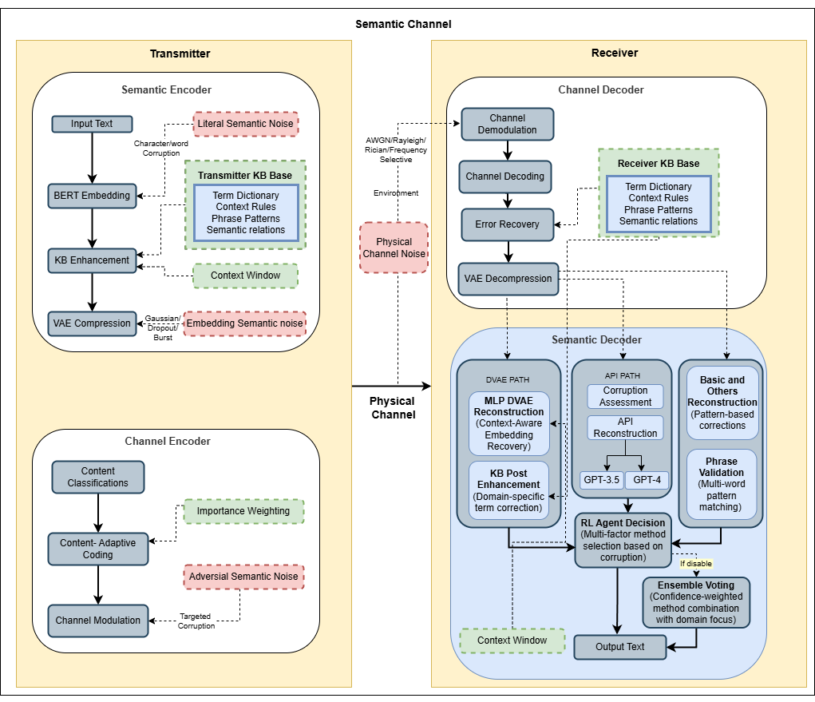
Proposed DSKB based SC Text Reconstruction Architecture
Text → Embedding: Convert input text to BERT embeddings
KB Enhancement: Apply domain knowledge to improve embedding quality
VAE Compression: Compress embedding for efficient transmission
Content Classification: Analyze content importance
Adaptive Coding: Apply stronger protection to important content
Channel Modulation: Convert to symbols for transmission
Physical Channel: Simulate transmission with noise and interference
Channel Demodulation: Convert symbols back to digital data
Channel Decoding: Apply error correction
Error Recovery: Apply semantic error recovery techniques
VAE Decompression: Decompress back to original dimension
Parallel Reconstruction Paths:
MLP DVAE reconstruction (embedding-based)
API reconstruction (text-based with RL decision)
Basic reconstruction (rule-based)
RL Agent Decision: RL agent serves as an intelligent decision-making system that optimizes the use of resources (particularly API budget) while maximizing reconstruction quality
Ensemble Voting: Combine multiple reconstructions
Output Text: Finalized reconstruction
Notes:
Transmitter Side
1. Semantic Encoder
Input Text → BERT Embedding Uses the helper in mlpdvae_utils.py to tokenize and embed each sentence into a 768-dim vector.
Example
[1. Literal Semantic Noise → “The cta sat on the mat.” │
│ └─ The raw text is first (optionally) corrupted at the word │
│ level to simulate typos or paraphrase errors.]
2. BERT Embedding │
│ └─ Maps words into a 768-dim vector capturing context.
KB Enhancement Pulls term dictionaries, context rules, phrase patterns and semantic relations from knowledge_base.py to refine raw embeddings before compression.
└─ Uses term dictionaries & context rules to “nudge” the │
│ embedding back toward correct semantics (e.g. recognize │
│ “cta” is likely “cat”).
VAE Compression Calls EmbeddingCompressorVAE.compress() in compression_vae.py, encoding the 768-dim BERT vector into a lower-dim latent (e.g. ~460-dim) via the VAE’s encoder mean (μ).
└─ `EmbeddingCompressorVAE.compress()` reduces 768→~460 dims, │
│ learning a lower-dim semantic bottleneck.
Embedding-Level Semantic Noise │
│ └─ Add small Gaussian jitter or dropout on the 460-dim vector.
2. Channel Encoder
Content Classification The EnhancedContentClassifier in content_adaptive_coding.py tags each sentence (e.g., factual vs. procedural) to drive unequal protection.
├─ Tag sentence as “factual” ⇒ high-priority protection.
Content-Adaptive Coding ContentAdaptivePhysicalChannel (via physical_semantic_integration.py) selects coding rates, interleaving, and importance-weighting profiles based on the classification.
└─ Choose strong FEC rate, interleaving pattern, weighting.
Channel Modulation Maps symbols onto OFDM subcarriers (QAM, IFFT/FFT, cyclic prefix) in physical_channel.py before transmission.
└─ Map bits to QAM symbols, IFFT, add cyclic prefix, etc.
Semantic Channel (Physical Environment)
Noise Models & Configuration Defined centrally in physical_channel_config.py: AWGN/Rayleigh/frequency-selective fading, pilot-based estimation, 16-QAM, CP length, semantic-noise bursts, etc.
Receiver Side
3. Channel Decoder
OFDM Demodulation & Channel Decoding In physical_channel.py, removes CP, FFT, equalizes, demaps soft bits, and applies FEC decoding to recover the corrupted latent vectors.
OFDM Demod & Channel Decoding │
│ └─ Remove CP, FFT, equalize, QAM demap, FEC decode.
Error Recovery (Circuit Breaker) The circuit_breaker.py logic triggers retransmits or API fallbacks if the decoded payload fails integrity checks.
Error Recovery (Circuit Breaker) │
│ └─ If CRC fails, request retransmit or trigger LLM fallback.
VAE Decompression Runs decompress_vae_embedding() from compression_vae.py to map the noisy latent back toward the original embedding space. └─ `decompress_vae_embedding()` maps 460-dim back toward 768-d.
4. Semantic Decoder
DVAE Path Reconstruction Loads/trains EnhancedMLPDVAE in semantic_mlpdvae.py, applies context-aware denoising (MSE + semantic­perceptual loss) to repair channel distortions.
└─ `EnhancedMLPDVAE` removes embedding-level noise using MSE + │
│ semantic loss training.
KB Post-Enhancement Reapplies term/context corrections from knowledge_base.py to the denoised embedding.
└─ Reinforce domain terms & phrase patterns from KnowledgeBase.
API Path generate_text_from_embedding() in semantic_evaluation.py queries GPT-3.5/4 (via config_manager.py + circuit_breaker.py) when embeddings are heavily corrupted.
Basic & Others Reconstruction Falls back on pattern-based, multi-word phrase matching (“Basic & Others”) using utilities in knowledge_base.py.
├ Leverage DVAE output │
│ LLM API path (GPT-3.5/4) if confidence < threshold │
│ Basic pattern matcher (phrase templates)
RL Agent Decision A small policy network in semantic_loss.py evaluates corruption features and picks the best path (DVAE vs. API vs. Basic).
└─ Chooses the best method based on estimated corruption level
Ensemble Voting semantic_evaluation.py then fuses the chosen outputs with confidence weights to yield the final text.
└─ Confidence-weighted fusion of DVAE, LLM, and pattern outputs.
Final Output Text │
│ └─ “The cat sat on the mat.”

Slide 12
Semantic vs. Direct Communication System Architecture
Aspect | Semantic Reconstruction | Direct Reconstruction (Conventional)
Fundamental Approach | Embedding-to-embedding-to-text (3-step) | Text-to-text (2-step)
Starting Point | Original text gets converted to embedding | Original text is used directly
Intermediate Representation | Works with numerical vector embeddings | Works directly with text characters/words
Dimension Reduction | VAE compression (768→460 dims) | Not applicable
Transmission Model | Physical channel simulation (SNR, modulation) | Simple text corruption model
Error Pattern | Continuous degradation across dimensions | Discrete character/word errors
Error Correction | DVAE neural reconstruction + text methods | Text methods only
KB Integration | KB enhances both embeddings and text | KB enhances text only
Context Utilization | Context window for embedding restoration | Context for word correction only
API Usage Trigger | Based on embedding similarity + text corruption | Based on text corruption only
Computational Cost | Higher (embedding operations + text) | Lower (text operations only)
Domain Knowledge | Enhanced parliamentary embedding features | Standard parliamentary text features
Primary Advantage | More robust to severe corruption | Simpler, faster, lower computation
RL Agent Role | Optimizes API choice based on embedding features | Simpler decision based on text features
Key Metrics | BLEU, ROUGE, METEOR, Semantic, Embedding similarity | BLEU, ROUGE, METEOR, Semantic
API Model Selection | Dynamic based on embedding and text features | Based primarily on text features
Primary Goal | Simulate real-world communication channel | Benchmark for comparison
Notes:
This comparison shows that while both paths can use the same reconstruction methods (KB, basic, API), the semantic path models a more complex communication system with intermediate vector representations, whereas the direct path provides a simpler text-only benchmark.
Embedding-to-embedding-to-text (3-step)
This cleanly separates bit‐level decoding (A), latent‐space denoising (B), and text synthesis (C), improving modularity and making each stage easier to train and debug.

Slide 13
Overall System Results Metrics (1)
Overall System Performance Metrics with Comparison.
Universal Rule of N-gram Level
Metric Type | BLEU (Bilingual Evaluation Understudy) | ROUGE-1 (Recall-Oriented Understudy for Gisting Evaluation) | ROUGE-L (Recall-Oriented Understudy for Gisting Evaluation - Longest Common Subsequence) | METEOR (Metric for Evaluation of Translation with Explicit Ordering) | SEMANTIC (Semantic Similarity)
Semantic Reconstruction | 0.3973 (This is not as much as important) | 0.7582 | 0.7506 | 0.6108 | 0.8519 (This value is important)
Direct Reconstruction (for comparison with Semantic comm) | 0.3819 | 0.7492 | 0.7443 | 0.6042 | 0.8553
Difference | +0.0154 | +0.0090 | +0.0063 | +0.0066 | -0.0034
N-gram Level | Perfect Match | With Punctuation Difference
Unigram (1-gram) | 1.0 | 0.95 (minor penalty)
Bigram (2-gram) | 1.0 | 0.90 (affected by punctuation)
Trigram (3-gram) | 1.0 | 0.85 (more affected)
4-gram | 1.0 | 0.80 (most affected)

Slide 14
Overall System Results Metrics (2)
BLEU Score (Bilingual Evaluation Understudy)
Exact n-gram matching between reconstruction and original text.
Example from system:
Original: This is all in accordance with the principles that we have always upheld .
Corrupted: This is all in accordance with the principles vtat we have always upheld .
Reconstructed: This is all in accordance with the principles that we have always upheld.
BLEU Score: 0.8446 ( Due to punctuation)
Contrasting example:
Original: "So Parliament should send a message, since that is the wish of the vast majority.“
Corrupted: "So Parliament should send a message, since that is the mmsh of the vast majority.“
Reconstructed: "So the Parliament should send a message, as this that the shall of the vast majorityy.“
BLEU Score: 0.2274
Here, the BLEU score is low (0.2274) because the reconstruction uses different words than the original, even though the meaning is preserved. The system added "the" before "Parliament" and restructured "since that is" to "as this that the" while changing "wish" to "shall".
Rough Scores (Recall-Oriented Understudy for Gisting Evaluation)
ROUGE-1 measures unigram (single word) overlap, while ROUGE-L measures longest common subsequence.
Example from System
Original: "Mrs Plooij-van Gorsel, I can tell you that this matter is on the agenda for the Quaestors' meeting on Wednesday.“
Corrupted: "Mrs Plooij-van Gorsel, I can tell you that this matter is on the agenda for the Quaestors' meeting on Wednesday.“
Reconstructed: "Mrs Plooij-van Gorsel, I Can inform you that this matter is on the agendaa for the Quaestors Meetingg on Wednesday.“
ROUGE-L Score: 0.8571
Despite changing "can tell" to "Can inform" and adding typos ("agendaa", "Meetingg"), the ROUGE-L score remains high (0.8571) because the longest common subsequence between original and reconstruction is substantial.

Slide 15
Overall System Results Metrics (3)
METEOR Score (Metric for Evaluation of Translation with Explicit Ordering)
METEOR evaluates translation quality by aligning words between the machine translation output and reference translation, handling synonyms, stems, and paraphrases.
It calculates precision and recall based on word matches, including exact matches, stemming, synonyms, and paraphrases, then applies penalties for fragmentation.
Example from system
Original: "I would like your advice about Rule 143 concerning inadmissibility.“
Corrupted: "I would like couw advice abxue Rule pv3 concerning inadmissibility.“
Reconstructed: "I would like your advice about Rulee 103 concerning inadmissibility.“
METEOR Score: ~0.61 (system average)
This example demonstrates how METEOR handles partial matches. Despite the number error ("143" → "103"), METEOR gives credit for the correct structure and most content words matching, resulting in a moderate-to-good score.
SEMANTIC Score (Semantic Similarity)
This measures the similarity between sentence embeddings of the reference and output text, capturing meaning rather than just lexical overlap.
Texts are converted to vector representations (embeddings) using language models, then cosine similarity between vectors is calculated.
Example from system
Original: "I would like your advice about Rule 143 concerning inadmissibility.“
Corrupted: "I would like couw advice abxue Rule pv3 concerning inadmissibility.“
Reconstructed: "I would like your advice about Rulee 103 concerning inadmissibility.“
SEMANTIC Score: 0.9831 {For Score 1.00 and same matching see the Bleu score example}
Despite the numbering error, this example shows an extremely high semantic score (0.9831) because the core meaning is preserved. The system fixed most corruptions ("couw" → "your", "abxue" → "about") while maintaining the parliamentary context about requesting advice regarding a rule concerning inadmissibility.

Slide 16
Overall System Results Metrics (4)
Enhanced Evaluation Results
The overall score of 0.7355 (73.55%) represents the weighted combined performance of the semantic communication system across all key dimensions.
The system achieves strong performance in domain relevance (0.8487), indicating excellent handling of parliamentary terminology. Semantic fidelity is also high (0.7941), showing good preservation of meaning.
The linguistic quality score (0.5887) is the lowest component, suggesting room for improvement in grammatical correctness and fluency.
The 0.7145 (71.45%) score indicates that approximately 71% of the essential information elements from the original messages were successfully preserved after transmission through the noisy channel and subsequent reconstruction.
System Configuration Results
The system was configured with a moderate noise level (0.15) using gaussian distribution, simulating realistic communication channel conditions.
The VAE compressor achieved approximately 40%-dimension reduction (768 → 460) while preserving semantic information. All advanced features were enabled, allowing for a comprehensive evaluation of the system's capabilities.
Evaluation Component | Score | What It Measures
Overall System Score | 0.7355 % | Weighted combination of components
Semantic Fidelity | 0.7941 % | Preservation of core meaning
Linguistic Quality | 0.5887 % | Grammar and fluency
Domain Relevance | 0.8487 % | Preservation of parliamentary terms
Information Preservation | 0.7145 % | Retention of key information
Parameter | Value
Number of Samples | 50
Noise Level | 0.15
Noise Type | gaussian
Embedding Dimension (Original) | 768
Compressed Dimension | 460
Compression Ratio | 59.9%
VAE Compression | Enabled
Semantic Loss | Enabled
Content-Adaptive Coding | Enabled
Physical Channel | Enabled

Slide 17
Overall System Results Metrics (5)
Reconstruction Method Distribution
The system leverages API-based reconstruction for approximately half of all samples, showing a preference for high-quality external models when accuracy is critical.
Knowledge base corrections are applied to 22% of samples, demonstrating the effectiveness of domain-specific reconstruction for parliamentary language.
Basic reconstruction handled simpler cases with lower corruption.
RL Agent Performance [Proximal Policy Optimization (PPO) Agent]
The reinforcement learning agent demonstrated efficient API usage, achieving high API efficiency (3638.14) while consuming only 2.48% of the available budget.
The agent maintained a moderate exploration rate (0.24), indicating continued learning while favoring exploitation of known successful strategies.
Method | Count | Percentage
KB (Knowledge Base) | 11 | 22%
Basic Reconstruction | ~15* | ~30%
API (GPT-3.5/GPT-4) | ~24* | ~48%
Metric | Value
Total Episodes | 627
Total Reward | 689.00
Final Exploration Rate | 0.24
API Efficiency | 3638.14
API Budget Used | $0.0496
API Budget Total | $2.00
Budget Utilization | 2.48%
Notes:
PPO gives us a stable, readily‐tuned on‐policy algorithm that efficiently learns when to invoke each reconstruction path, handles our small discrete action set with low variance, and resists large destructive policy updates—making it ideal for the “choose‐one‐of‐three” decision problem in our semantic‐communication system.

Slide 18
Overall System Results Metrics (6)
Physical Channel Performance Analysis
Physical Channel Configuration
The system employs a sophisticated frequency-selective channel model with OFDM-16 modulation, operating at a moderate SNR of 18dB.
This configuration represents realistic wireless communication conditions.
The adaptive modulation thresholds (15 dB and 25 dB) allow the system to dynamically adjust modulation complexity based on channel conditions, optimizing the tradeoff between data rate and error resilience.
Content-Adaptive Channel Performance
The content-adaptive channel implements intelligent protection mechanisms that prioritize semantically important information.
By using a neural network classifier to analyze embedding content, the system can allocate stronger error protection to critical parts of the message, improving overall semantic preservation under noise conditions.
Parameter | Value
Channel Type | frequency selective
Modulation Scheme | ofdm-16
Signal-to-Noise Ratio (SNR) | 18.0 dB
Adaptive Modulation | Enabled
Modulation Thresholds | 15.0dB and 25.0dB
Unequal Error Protection | Enabled (3 protection levels)
Content-Adaptive Coding | Enabled
Feature | Implementation | Function
Content Classifier | Neural network | Analyzes embedding content importance
Protection Levels | 3 tiers Adaptive FEC rates (High-1/2 priority bits, Medium-3/4,Low-7/8) | Applies different error protection based on content priority
Embedding Dimension | 460 | Optimized for content classification
Adaptive Modulation | SNR-based switching | Adjusts modulation based on channel quality
Channel Type | Frequency-selective | Models realistic multipath fading conditions
Notes:
The ContentAdaptivePhysicalChannel module in content_adaptive_coding.py uses UEP to map semantic importance → coding parameters, ensuring our most meaningful latent dimensions get the strongest protection through the OFDM link.

Slide 19
Overall System Results Metrics (7)
Physical-Semantic Integration Performance
The physical-semantic integration demonstrates effective cross-layer optimization.
By compressing the original 768-dimensional embeddings to 460 dimensions and applying content-adaptive protection, the system maintains high semantic scores (0.8519) despite channel noise.
The unequal error protection mechanism particularly benefits parliamentary domain content, explaining the high domain relevance score (0.8487).
Metric | Improvement Over Baseline
Embedding Similarity | Maintained at high levels despite compression and noise
Semantic Preservation | Enhanced through content-adaptive coding
Domain-Specific Protection | Prioritizes parliamentary terminology
Compression Efficiency | 40%-dimension reduction with minimal semantic loss
Channel Utilization | Improved through unequal error protection

Slide 20
Overall System Results Metrics (8)
Semantic Channel Performance Analysis
Semantic Model Configuration
The semantic channel uses a sophisticated MLP-based Denoising Variational Autoencoder with substantial neural capacity (920-dimensional hidden layer).
The model maintains the same dimension for input and latent space (460), suggesting an emphasis on faithful representation rather than extreme compression.
The BERT-based semantic perceptual loss provides gradient information based on semantic similarity rather than just pixel-wise reconstruction accuracy.
Component | Configuration | Purpose
Model Type | Enhanced MLP-DVAE | Denoising and semantic preservation
Input Dimension | 460 | Matches compressed embedding size
Hidden Dimension | 920 | Internal representation capacity
Latent Dimension | 460 | Semantic encoding dimension
Semantic Loss | BERT-based perceptual loss | Measures semantic similarity
Self-Supervised Training | Enabled | Improves reconstruction quality
Text-Guided Decoding | Enabled | Incorporates semantic context
Context Window Size | 3 | Number of previous messages for context

Slide 21
Overall System Results Metrics (9)
Semantic Context Integration Performance
The semantic channel integrates multiple context sources to enhance reconstruction quality.
The systems ability to leverage previous messages, knowledge base information, and text hints during decoding creates a robust semantic framework.
This multi-faceted approach explains the strong domain relevance scores and the system's ability to maintain semantic consistency across corrupted messages.
Performance by Message Type
The semantic channel performs best on parliamentary-specific content, particularly with institutional terms and procedural language.
This suggests effective domain specialization.
The system shows appropriate method selection based on content type, with the knowledge base handling domain-specific terms while API methods address more complex linguistic structures.
Feature | Implementation | Effect
Context Window Size | 3 previous messages | Provides conversational continuity
Text-Guided Decoding | Conditioning on available text | Improves semantic coherence
KB Integration | Domain-specific knowledge base | Enhances parliamentary term reconstruction
Critical Term Enhancement | Parliamentary terminology focus | Prioritizes domain-specific vocabulary
Enhanced Evaluation | Multi-component semantic metrics | More nuanced performance assessment
Message Characteristic | Semantic Score | Common Methods
High Parliamentary Content | 0.86-0.95 | KB + API
Names and Institutions | 0.82-0.90 | KB for known terms
Procedural Language | 0.80-0.88 | Basic + KB
General Discussion | 0.75-0.85 | Basic + API
Complex/Long Sentences | 0.70-0.82 | API preferred
Notes:
In our framework, “context window size = 3 previous messages” means that, at each new turn, we explicitly carry forward the last three utterances so the semantic encoder and downstream modules can maintain continuity.
By explicitly concatenating and fusing the last three message embeddings before VAE compression, the system preserves conversational continuity—ensuring that every component from KB enhancement through RL decision has access to just enough recent history to resolve context‐dependent semantics.

Slide 22
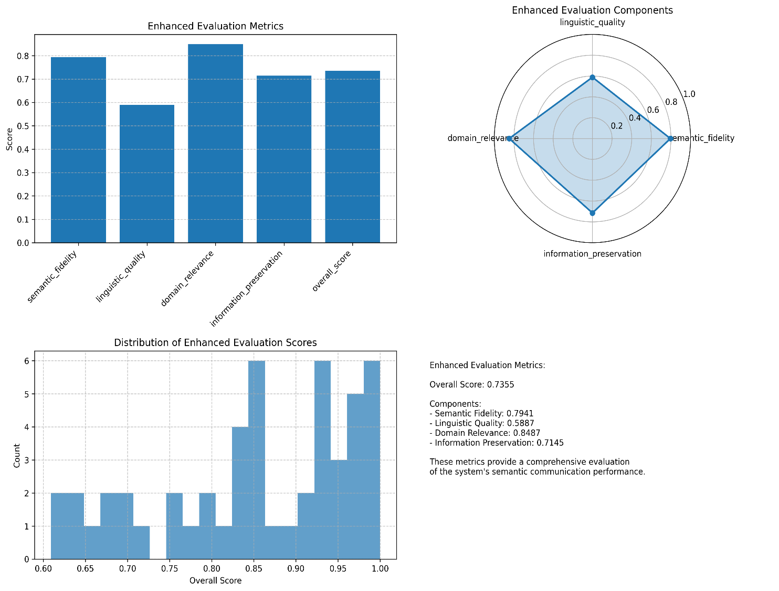
Overall System Results Visualization (1)
System Enhanced Evaluation Metrics
Bar Chart: Enhanced Evaluation Metrics
Radar Chart: Enhanced Evaluation Components
Histogram: Distribution of Enhanced Evaluation Scores
Peak at 0.85: Most samples cluster around the 0.85 score, forming the primary performance mode
Secondary Peak at 0.95-1.00: A substantial number of samples achieve near-perfect scores
Fewer Samples at 0.60-0.75: Lower-performing samples are less common, showing consistent performance
Multi-modal Distribution: The distinct peaks suggest different performance levels for different types of content
Text Summary and Integrated Analysis
The visualization effectively demonstrates the system's intentional design priorities: preserving parliamentary terminology and message meaning are prioritized over perfect grammar. This aligns with the practical needs of a semantic communication system where conveying accurate domain-specific information is more critical than linguistic perfection.

Slide 23
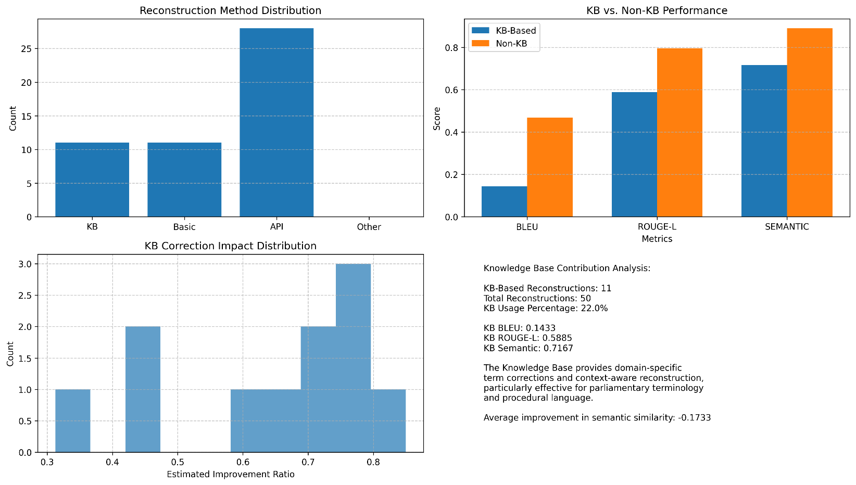
Overall System Results Visualization (2)
Knowledge Base Contribution Visualizations
The visualizations collectively reveal KB's specialized role in the Europearl system:
Selective Application: KB is applied to approximately 22% of cases where its domain-specific knowledge provides advantages.
Semantic Strength: While underperforming in exact word matching (BLEU: 0.14), KB achieves respectable semantic similarity scores (0.7167), indicating it preserves meaning despite wording differences.
High-Impact Corrections: When KB is successfully applied, it frequently achieves high improvement ratios (0.7-0.8), demonstrating substantial improvements in select cases..
Domain Specialization: KB's particular value lies in handling parliamentary terminology and procedural language, where its specialized knowledge base provides advantages that more general methods might miss.

Slide 24
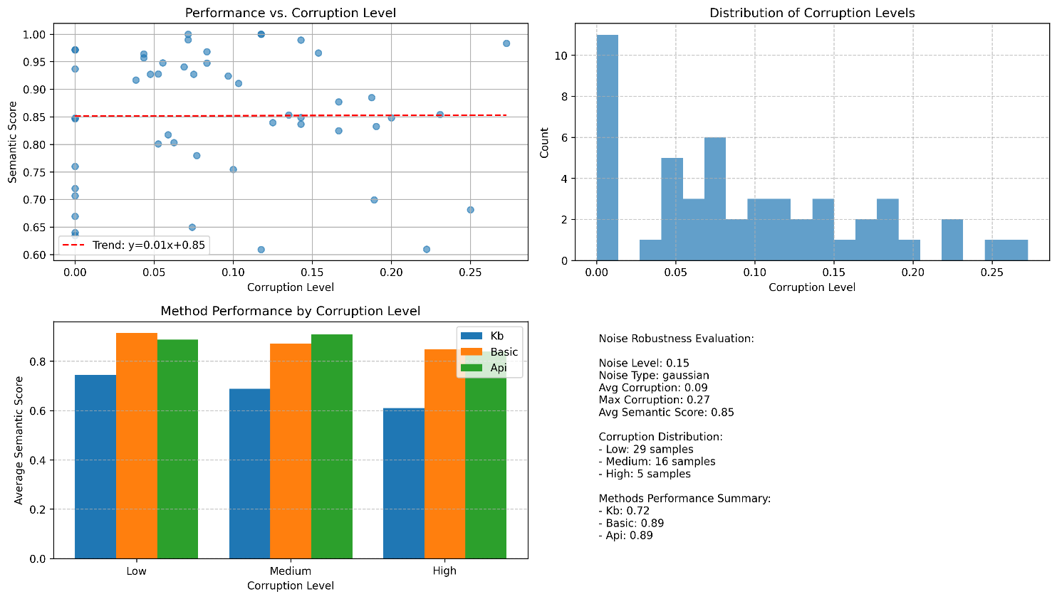
Overall System Results Visualization (3)
Noise Robustness Evaluation Visualizations
These visualizations collectively reveal several key insights about the system's noise robustness.
Performance vs. Corruption Level
Trend line equation: y=0.01x+0.85, indicating a nearly flat relationship
Semantic score range: 0.60-1.00, with most points clustered above 0.85
The minimal slope (0.01) confirms the system maintains consistent semantic performance even as corruption increases
Performance stability: Despite corruption levels ranging from 0.0 to 0.27, semantic scores show only minor degradation
The flat trend line is particularly significant as it demonstrates the system's robustness to noise - semantic performance remains relatively stable regardless of corruption severity. This suggests effective error recovery mechanisms across varying noise conditions.
Distribution of Corruption Levels
Low corruption dominance: ~11 samples at near-zero corruption, representing the largest group
Right-skewed distribution: Most samples (29) experienced corruption levels below 0.10
Graduated challenge: Progressive reduction in sample counts as corruption increases
Testing range: Full range extends to 0.27, providing comprehensive evaluation across corruption conditions
The distribution confirms the test setup effectively evaluated system performance across the full spectrum of corruption levels, with sufficient representation of challenging high-corruption cases (5 samples above 0.20).
Method Performance by Corruption Level
KB degradation: KB shows consistent performance decline as corruption increases
Basic reliability: Basic method maintains remarkably consistent performance across all corruption levels
API advantage window: API performs best at medium corruption levels but experiences significant degradation at high corruption
Method complementarity: Different methods excel under different conditions, justifying the multi-method approach
The data confirms the system effectively handles a wide range of corruption conditions while maintaining semantic integrity, with the multi-method approach providing important resilience through method complementarity.

Slide 25
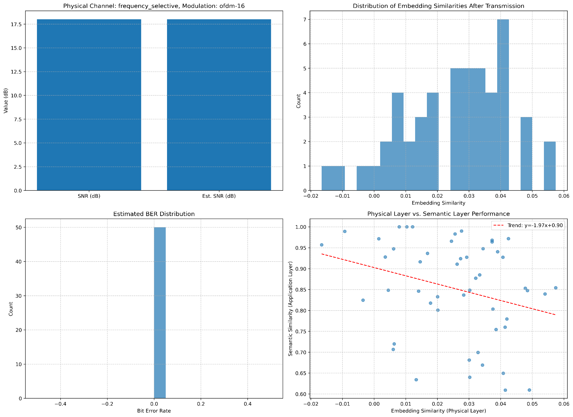
Overall System Results Visualization (4)
Distribution of Embedding Similarities After Transmission
Range: -0.02 to 0.06
Peak frequency: Around 0.04 (7 samples)
Distribution shape: Right-skewed with positive mean
Majority range: Most samples fall between 0.02-0.05
The predominantly positive similarity values indicate the system successfully preserves embedding relationships through the channel. The right-skewed distribution with peak at 0.04 suggests most transmissions maintain moderate similarity, with few instances of negative similarity (signal inversion). This demonstrates the effectiveness of the channel coding mechanisms in preserving embedding relationships despite noise.
Estimated BER Distribution
All 50 samples report 0 bit errors, confirming the combined OFDM-16, adaptive modulation and unequal error protection scheme fully mitigates errors.
Physical Layer vs. Semantic Layer Performance
Trend line equation: y = -1.97x + 0.90
Correlation direction: Negative slope (-1.97)
Baseline semantic performance: 0.90 y-intercept
Data distribution: Significant scatter around trend line
Range: Semantic similarity spans 0.60-1.00 across physical similarities
The counterintuitive negative correlation reveals a crucial insight: better physical layer embedding similarity doesn't necessarily translate to improved semantic performance.
This suggests the system's semantic layer implements effective compensation mechanisms that work harder when physical layer performance degrades.
The substantial scatter around the trend line indicates other factors beyond physical similarity influence semantic performance.
Physical Channel Performance Visualizations
Physical Channel Parameters
Configured SNR: 18 dB
Estimated SNR: 18 dB
Channel type: frequency selective
Modulation scheme: OFDM-16 (Orthogonal Frequency Division Multiplexing with 16-QAM)
The perfect alignment between configured and estimated SNR values indicates excellent channel estimation accuracy. This 18 dB operating point represents a moderately challenging wireless channel environment while maintaining reliable communication. The frequency-selective channel model realistically simulates real-world wireless communications with frequency-dependent fading effects

Slide 26
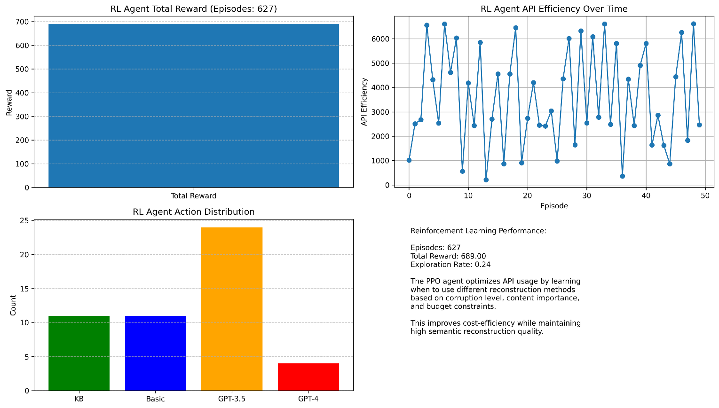
Overall System Results Visualization (5)
RL Agent Performance Visualizations
Total Reward
627 episodes, 689 total reward (~1.1 per episode)
Indicates the PPO agent has learned an effective policy for balancing quality and cost.
API Efficiency Over Time
Range: ~0–6 500 efficiency units
Pattern: Volatile with repeated peaks
Shows context-sensitive decisions rather than a simple learning curve.
Action Distribution
GPT-3.5: 49% | KB: 22% | Basic: 22% | GPT-4: 8%
Reflects a strategic cost-quality trade-off: heavy use of mid-tier GPT-3.5, sparing use of expensive GPT-4.
Key Metrics
Episodes: 627 | Total Reward: 689 | Exploration Rate: 24%
Maintains a healthy exploration/exploitation balance for ongoing adaptation.

Slide 27
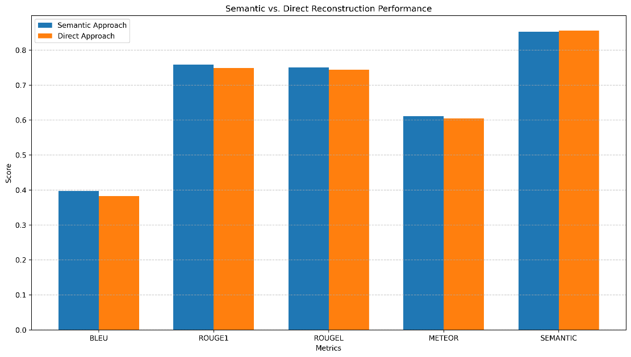
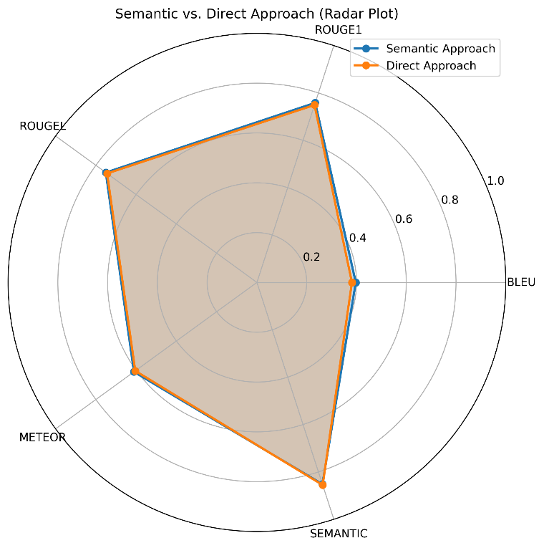
Overall System Results Visualization (6)
Semantic Vs Direct Reconstruction
The Semantic approach consistently outperforms the Direct approach across traditional metrics (BLEU, ROUGE1, ROUGEL, METEOR) by small margins (0.01-0.02), while the Direct approach slightly edges ahead on SEMANTIC similarity (0.8553 vs 0.8519), indicating both approaches effectively preserve meaning with the Semantic approach offering marginally better lexical and structural preservation.
The radar plot reveals nearly identical performance profiles between approaches, with the Semantic Approach (blue) showing minimal advantages in ROUGE1, ROUGEL, BLEU and METEOR metrics, while the Direct Approach (orange) has a slight edge in SEMANTIC similarity; both approaches demonstrate similar strength patterns, performing best on semantic preservation metrics and weakest on exact word-matching (BLEU).

Slide 28
Q & A
Notes:
28

Slide 29
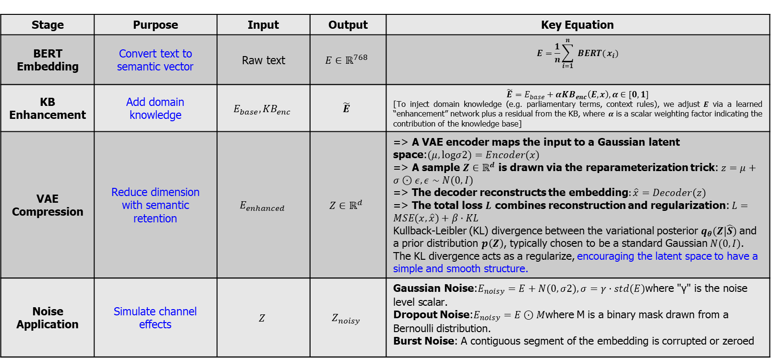
Appendix (Semantic Encoder Pipeline)
The Semantic Encoder Pipeline combines the power of BERT embeddings, knowledge base enhancement, and VAE compression to generate compact, semantically rich representations of input text.
The pipeline leverages state-of-the-art techniques from natural language processing and deep learning to capture and preserve the essential meaning of the text while reducing its dimensionality for efficient communication.
Stage | Purpose | Input | Output | Key Equation
BERT Embedding | Convert text to semantic vector | Raw text | $$E∈ℝ^{768}$$ | $$E=\frac{1}{n}\sum_{i=1}^{n}{ BERT(}x_{i})$$
KB Enhancement | Add domain knowledge | $$E_{base},{KB}_{enc}$$ | $$\tilde{E}$$ | $$\tilde{E}=E_{base}+α{KB}_{enc}\left(E,x\right),α∈[0,1]$$ [To inject domain knowledge (e.g. parliamentary terms, context rules), we adjust $E$ via a learned “enhancement” network plus a residual from the KB, where $α$ is a scalar weighting factor indicating the contribution of the knowledge base]
VAE Compression | Reduce dimension with semantic retention | $$E_{enhanced}$$ | $$Z∈ℝ^{d}$$ | => A VAE encoder maps the input to a Gaussian latent space:$(μ,logσ2)=Encoder(x)$ => A sample $Z∈ℝ^{d}$ is drawn via the reparameterization trick: $z=μ+σ⊙ε,ε∼N(0,I)$ => The decoder reconstructs the embedding$:\hat{x}=Decoder(z)$ => The total loss $L$ combines reconstruction and regularization: $L=MSE(x,\hat{x})+β⋅KL$ Kullback-Leibler (KL) divergence between the variational posterior $q_{θ}(Z|\hat{S})$and a prior distribution $p\left(Z\right)$, typically chosen to be a standard Gaussian $N(0,I)$. The KL divergence acts as a regularize, encouraging the latent space to have a simple and smooth structure.
Noise Application | Simulate channel effects | $$Z$$ | $$Z_{noisy}$$ | Gaussian Noise:$E_{noisy}​=E+N(0,σ2),σ=γ⋅std(E)\text{where}$"γ"$\text{is} \text{the} \text{noise} \text{level} \text{scalar}\text{.}$ Dropout Noise:$E_{noisy}​=E⊙M$where M is a binary mask drawn from a Bernoulli distribution. Burst Noise: A contiguous segment of the embedding is corrupted or zeroed

Slide 30
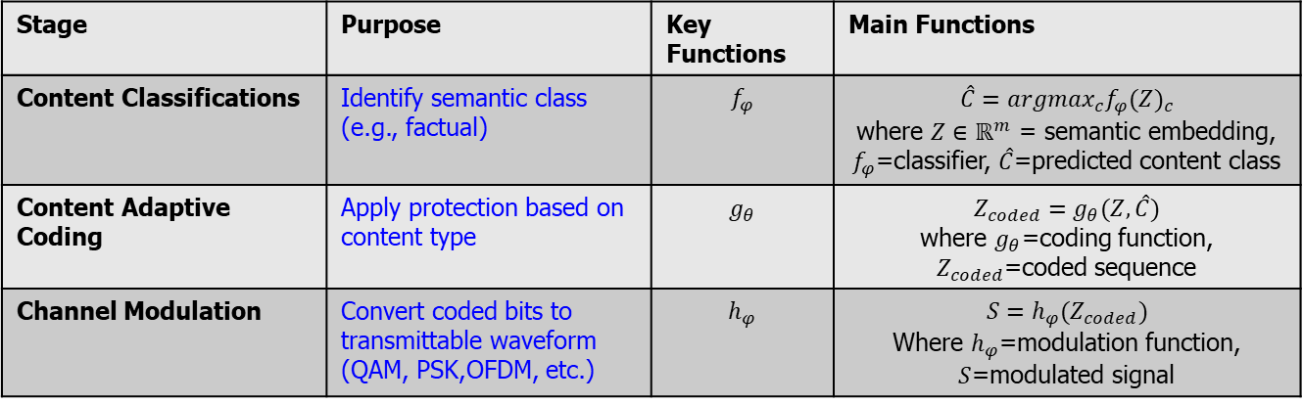
Appendix (Channel Encoder Pipeline - 1)
Primary objective is to prepare the compressed semantic embeddings for transmission over a physical communication channel.
The pipeline leverages techniques from digital communication and machine learning to ensure efficient and reliable transmission of semantic information over noisy channels.
Content Classifications
Procedural -> Text describing how the Parliament operates—its rules, agendas, sessions, and motions.
Legislative -> Text about laws, directives, amendments and formal proposals under consideration.
Factual -> Statements of data, reports, statistics or findings—used when conveying evidence or analysis.
Argumentative-> Language used to express opinions, debate positions, or persuade—often with contrastive or evaluative phrases.
Stage | Purpose | Key Functions | Main Functions
Content Classifications | Identify semantic class (e.g., factual) | $$f_{φ}$$ | $$\hat{C}={argmax}_{c}f_{φ}{(Z)}_{c}$$ where $Z∈ℝ^{m}$ = semantic embedding, $f_{φ}$=classifier, $\hat{C}$=predicted content class
Content Adaptive Coding | Apply protection based on content type | $$g_{θ}$$ | $$Z_{coded}=g_{θ}(Z,\hat{C})$$ where $g_{θ}$=coding function, $Z_{coded}$=coded sequence
Channel Modulation | Convert coded bits to transmittable waveform (QAM, PSK,OFDM, etc.) | $$h_{φ}$$ | $$S=h_{φ}(Z_{coded})$$ Where $h_{φ}$=modulation function, $S$=modulated signal

Slide 31
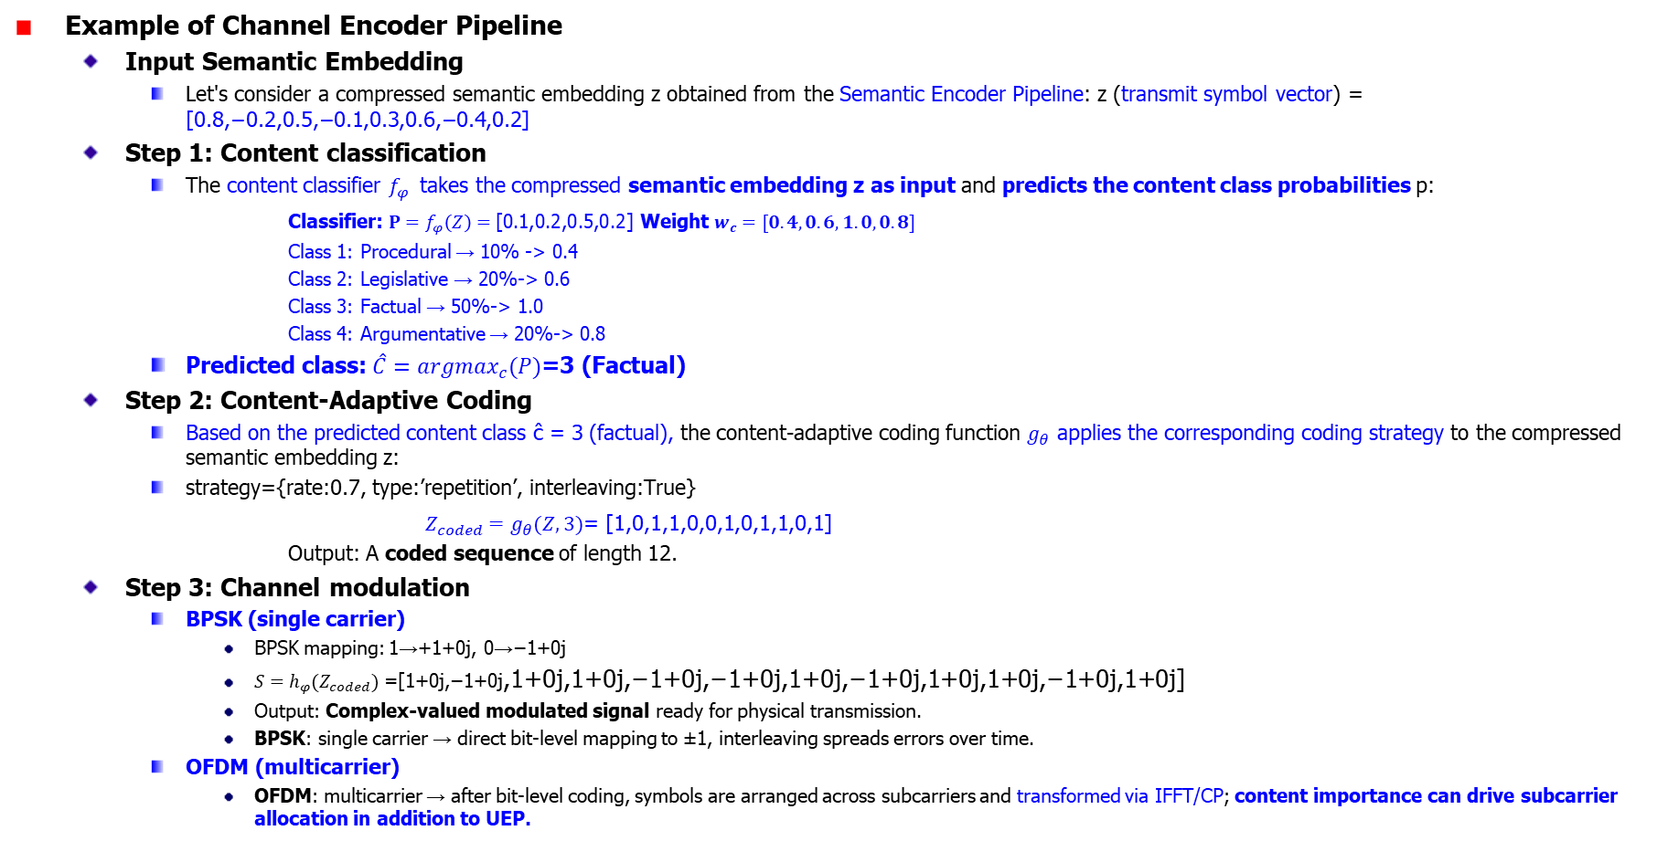
Appendix (Channel Encoder Pipeline - 2)
Example of Channel Encoder Pipeline
Input Semantic Embedding
Let's consider a compressed semantic embedding z obtained from the Semantic Encoder Pipeline: z (transmit symbol vector) = [0.8,−0.2,0.5,−0.1,0.3,0.6,−0.4,0.2]
Step 1: Content classification
The content classifier $f_{φ}$ takes the compressed semantic embedding z as input and predicts the content class probabilities p:
Classifier: $P=f_{φ}\left(Z\right)=\text{[0.1,0.2,0.5,0.2]}$ Weight $w_{c}=[0.4,0.6,1.0,0.8]$
Class 1: Procedural → 10% -> 0.4
Class 2: Legislative → 20%-> 0.6
Class 3: Factual → 50%-> 1.0
Class 4: Argumentative → 20%-> 0.8
Predicted class: $\hat{C}={argmax}_{c}(P)$=3 (Factual)
Step 2: Content-Adaptive Coding
Based on the predicted content class ĉ = 3 (factual), the content-adaptive coding function $g_{θ}$ applies the corresponding coding strategy to the compressed semantic embedding z:
strategy={rate:0.7, type:’repetition’, interleaving:True}
$Z_{coded}=g_{θ}(Z,3)$= [1,0,1,1,0,0,1,0,1,1,0,1]
Output: A coded sequence of length 12.
Step 3: Channel modulation
BPSK (single carrier)
BPSK mapping: 1→+1+0j, 0→−1+0j
$S=h_{φ}(Z_{coded})$=[1+0j,−1+0j,1+0j,1+0j,−1+0j,−1+0j,1+0j,−1+0j,1+0j,1+0j,−1+0j,1+0j]
Output: Complex-valued modulated signal ready for physical transmission.
BPSK: single carrier → direct bit‐level mapping to ±1, interleaving spreads errors over time.
OFDM (multicarrier)
OFDM: multicarrier → after bit‐level coding, symbols are arranged across subcarriers and transformed via IFFT/CP; content importance can drive subcarrier allocation in addition to UEP.
Notes:
Building on your classification example, here’s how we turn those class probabilities into an importance factor, and then map that factor into UEP parameters (FEC rate, interleaver depth, power boost).
1. Compute Importance Factor from Class Probabilities
Let’s assign each content class a weight wcw_cwc​ reflecting its semantic criticality:
ClassProbability PcP_cPc​Weight wcw_cwc​Procedural (1)0.10.4Legislative (2)0.20.6Factual (3)0.51.0Argumentative (4)0.20.8
We then compute a soft importance score by a weighted sum:
importance=∑c=14Pc wc=0.1⋅0.4+0.2⋅0.6+0.5⋅1.0+0.2⋅0.8=0.04+0.12+0.50+0.16=0.82\text{importance} = \sum_{c=1}^4 P_c \,w_c = 0.1\cdot0.4 + 0.2\cdot0.6 + 0.5\cdot1.0 + 0.2\cdot0.8 = 0.04 + 0.12 + 0.50 + 0.16 = 0.82importance=c=1∑4​Pc​wc​=0.1⋅0.4+0.2⋅0.6+0.5⋅1.0+0.2⋅0.8=0.04+0.12+0.50+0.16=0.82 This 0.82∈[0,1]0.82\in[0,1]0.82∈[0,1] tells us “how important” this embedding is.
2. Map Importance → UEP Settings
Pick ranges for your UEP parameters:
FEC code rate r ∈ [rmax⁡, rmin⁡r_{\max},\,r_{\min}rmax​,rmin​] = [0.9, 0.5]
Interleaver depth d ∈ [dmin⁡, dmax⁡d_{\min},\,d_{\max}dmin​,dmax​] = [16, 64] symbols
Power gain g ∈ [gmin⁡, gmax⁡g_{\min},\,g_{\max}gmin​,gmax​] = [0 dB, 3 dB]
Then interpolate linearly:
Code Rate
r=rmax⁡−importance×(rmax⁡−rmin⁡)=0.9−0.82×(0.9−0.5)=0.9−0.82×0.4≈0.572 r = r_{\max} - \text{importance}\times(r_{\max}-r_{\min}) = 0.9 - 0.82\times(0.9-0.5) = 0.9 - 0.82\times0.4 \approx 0.572r=rmax​−importance×(rmax​−rmin​)=0.9−0.82×(0.9−0.5)=0.9−0.82×0.4≈0.572
Interleaver Depth
d=dmin⁡+importance×(dmax⁡−dmin⁡)=16+0.82×(64−16)=16+0.82×48≈55 symbols d = d_{\min} + \text{importance}\times(d_{\max}-d_{\min}) = 16 + 0.82\times(64-16) = 16 + 0.82\times48 \approx 55\text{ symbols}d=dmin​+importance×(dmax​−dmin​)=16+0.82×(64−16)=16+0.82×48≈55 symbols
Power Gain
g=gmin⁡+importance×(gmax⁡−gmin⁡)=0+0.82×3≈2.46 dB g = g_{\min} + \text{importance}\times(g_{\max}-g_{\min}) = 0 + 0.82\times3 \approx 2.46\text{ dB}g=gmin​+importance×(gmax​−gmin​)=0+0.82×3≈2.46 dB
3. Resulting UEP Profile for This Sample
ParameterValueImportance factor0.82FEC code rate≈ 0.57 (≈ ½ for strong protection) Interleaver depth≈ 55 symbolsPower gain≈ +2.5 dB
Because this sentence was judged 50% factual (the highest‐weight class), its importance factor is high (0.82), so we allocate strong FEC, deep interleaving, and a moderate power boost—ensuring those critical semantic bits survive the OFDM channel with minimal errors.

Slide 32
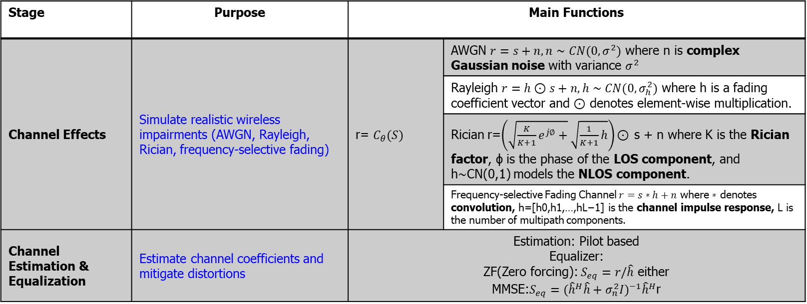

Appendix (Physical Channel Pipeline - 1)
The Physical Channel Pipeline simulates the transmission of modulated signals through realistic communication environments, introducing noise and channel impairments to mimic practical conditions.
Channel Effects
Transmitted signal undergoes distortion: $r\left[n\right]=\sum_{l}{h_{l}.S_{mod}\left[n−1\right]+w[n]}$ >-> Results: r=[0.8+0.2j,−0.9−0.1j,0.7+0.3j,…]
Channel Estimation & Equalization
Using MMSE [minimize the expected squared error] equalization:$S_{eq}={({\hat{h}}^{H}\hat{h}+σ_{n}^{2}I)}^{−1}{\hat{h}}^{H}$r ->-> Results: seq​=[0.9+0.1j,−1.1−0.05j,0.95+0.15j,…]
Stage | Purpose | Main Functions
Channel Effects | Simulate realistic wireless impairments (AWGN, Rayleigh, Rician, frequency-selective fading) | r= $C_{θ}(S)$ | AWGN $r=s+n,n∼CN(0,σ^{2})$ where n is complex Gaussian noise with variance $σ^{2}$
 |  |  | Rayleigh $r=h⊙s+n,h∼CN(0,σ_{h}^{2})$ where h is a fading coefficient vector and ⊙ denotes element-wise multiplication.
 |  |  | Rician r=$\left(\sqrt{\frac{K}{K+1}e^{j∅}+}\sqrt{\frac{1}{K+1}h}\right)\text{⊙}$ s + n where K is the Rician factor, ϕ is the phase of the LOS component, and h∼CN(0,1) models the NLOS component.
 |  |  | Frequency-selective Fading Channel $r=s∗h+n$ where ∗ denotes convolution, h=[h0​,h1​,…,hL−1​] is the channel impulse response, L is the number of multipath components.
Channel Estimation & Equalization | Estimate channel coefficients and mitigate distortions | Estimation: Pilot based Equalizer: ZF(Zero forcing): $S_{eq}=r/\hat{h}$ either MMSE:$S_{eq}={({\hat{h}}^{H}\hat{h}+σ_{n}^{2}I)}^{−1}{\hat{h}}^{H}$r

Slide 33
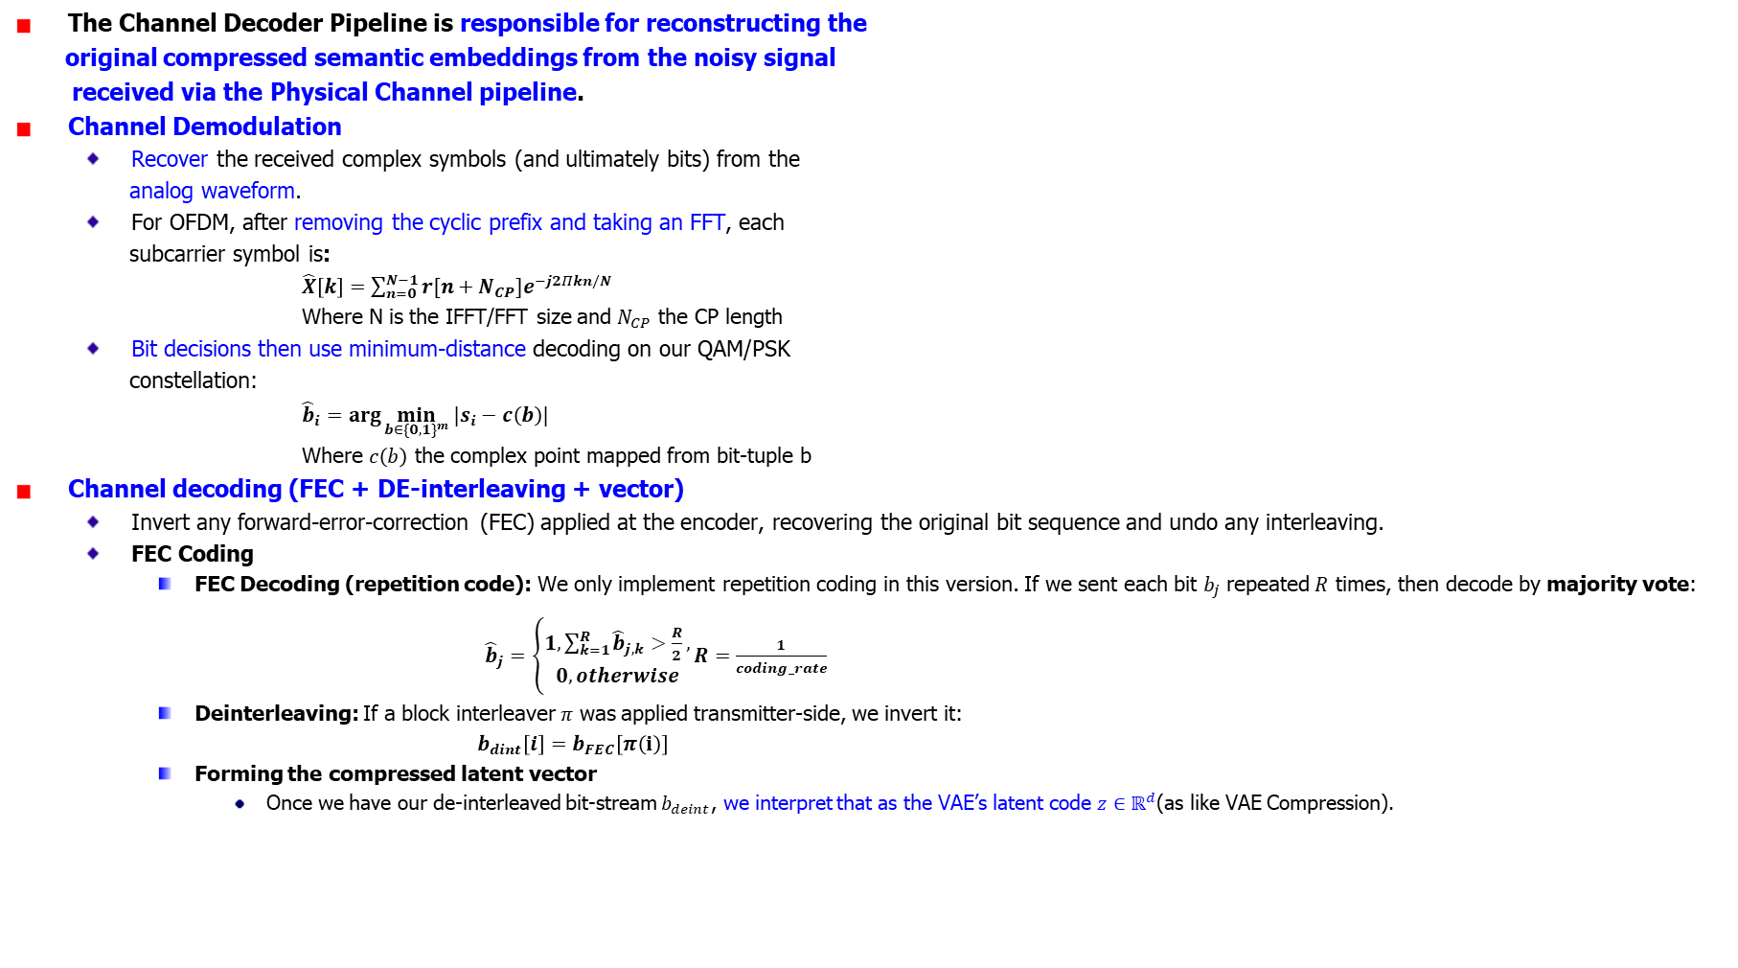
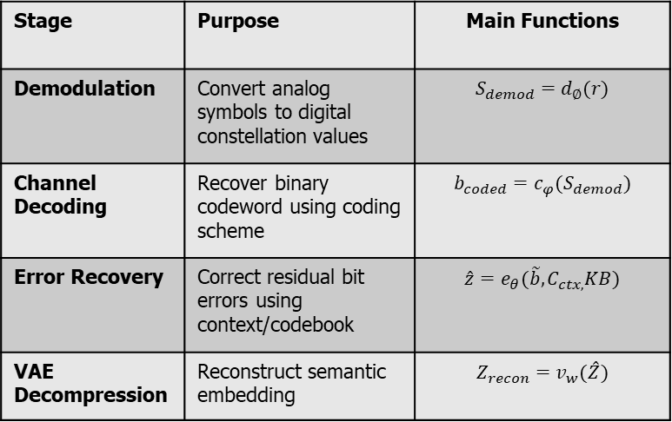
Appendix (Channel Decoder Pipeline - 1)
The Channel Decoder Pipeline is responsible for reconstructing the
original compressed semantic embeddings from the noisy signal
received via the Physical Channel pipeline.
Channel Demodulation
Recover the received complex symbols (and ultimately bits) from the
analog waveform.
For OFDM, after removing the cyclic prefix and taking an FFT, each
subcarrier symbol is:
$\hat{X}\left[k\right]=\sum_{n=0}^{N−1}{r[n+N_{CP}]e^{−j2Πkn/N}}$
Where N is the IFFT/FFT size and $N_{CP}$ the CP length
Bit decisions then use minimum‐distance decoding on our QAM/PSK
constellation:
${\hat{b}}_{i}=\arg{\min_{b∈{\{0,1\}}^{m}}{|s_{i}−c\left(b\right)|}}$
Where $c\left(b\right)$ the complex point mapped from bit-tuple b
Channel decoding (FEC + DE-interleaving + vector)
Invert any forward‐error‐correction (FEC) applied at the encoder, recovering the original bit sequence and undo any interleaving.
FEC Coding
FEC Decoding (repetition code): We only implement repetition coding in this version. If we sent each bit $b_{j}$ repeated $R$ times, then decode by majority vote:
${\hat{b}}_{j}=\left\{\begin{aligned}1, \sum_{k=1}^{R}{{\hat{b}}_{j,k}>\frac{R}{2},} \\ 0, otherwise\end{aligned}\right.R=\frac{1}{coding_rate}$
Deinterleaving: If a block interleaver $π$ was applied transmitter-side, we invert it:
$b_{dint}\left[i\right]=b_{FEC}\left[π\left(i\right)\right]$
Forming the compressed latent vector
Once we have our de-interleaved bit‐stream $b_{deint}$​, we interpret that as the VAE’s latent code $z∈ℝ^{d}$(as like VAE Compression).
Stage | Purpose | Main Functions
Demodulation | Convert analog symbols to digital constellation values | $$S_{demod}=d_{∅}(r)$$
Channel Decoding | Recover binary codeword using coding scheme | $$b_{coded}=c_{φ}(S_{demod})$$
Error Recovery | Correct residual bit errors using context/codebook | $$\hat{z}=e_{θ}(\tilde{b},C_{ctx,}KB)$$
VAE Decompression | Reconstruct semantic embedding | $$Z_{recon}=v_{w}(\hat{Z})$$
Notes:
Remove CP so that what remains is one circularly convolved symbol of length NNN.
Take FFT (equation 1) to compute each subcarrier’s coefficient. The Fast Fourier Transform (FFT) is simply an efficient algorithm for computing the Discrete Fourier Transform (DFT)

Slide 34
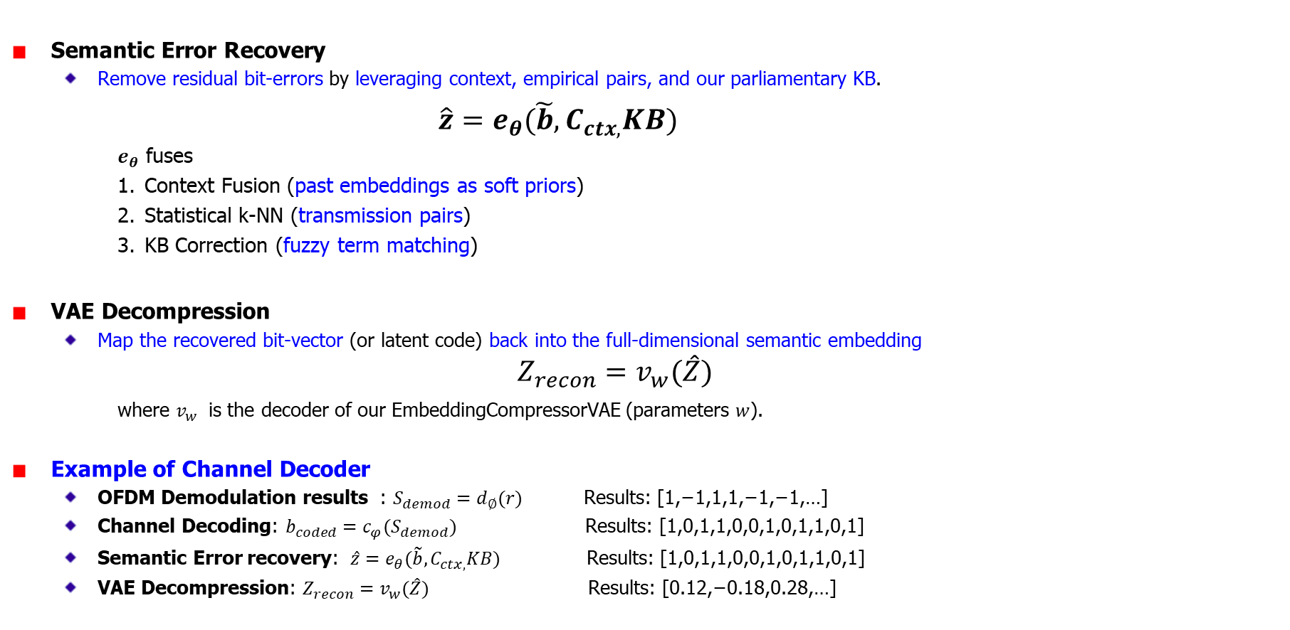
Appendix (Channel Decoder Pipeline - 2)
Semantic Error Recovery
Remove residual bit-errors by leveraging context, empirical pairs, and our parliamentary KB.
$\hat{z}=e_{θ}(\tilde{b},C_{ctx,}KB)$
$e_{θ}$ fuses
Context Fusion (past embeddings as soft priors)
Statistical k-NN (transmission pairs)
KB Correction (fuzzy term matching)
VAE Decompression
Map the recovered bit-vector (or latent code) back into the full-dimensional semantic embedding
$$Z_{recon}=v_{w}(\hat{Z})$$
where $v_{w}$​ is the decoder of our EmbeddingCompressorVAE (parameters $w$).
Example of Channel Decoder
OFDM Demodulation results : $S_{demod}=d_{∅}(r)$ Results: [1,−1,1,1,−1,−1,…]
Channel Decoding: $b_{coded}=c_{φ}(S_{demod})$ Results: [1,0,1,1,0,0,1,0,1,1,0,1]
Semantic Error recovery: $\hat{z}=e_{θ}(\tilde{b},C_{ctx,}KB)$ Results: [1,0,1,1,0,0,1,0,1,1,0,1]
VAE Decompression: $Z_{recon}=v_{w}(\hat{Z})$ Results: [0.12,−0.18,0.28,…]
Notes:
Fuzzy term matching is an approximate string‐matching technique used in your Basic/Pattern reconstruction path to correct or validate domain terms that may have been garbled by noise. Instead of requiring an exact dictionary lookup, fuzzy matching finds the closest dictionary entry to a given (possibly misspelled or distorted) token based on a similarity metric.

Slide 35
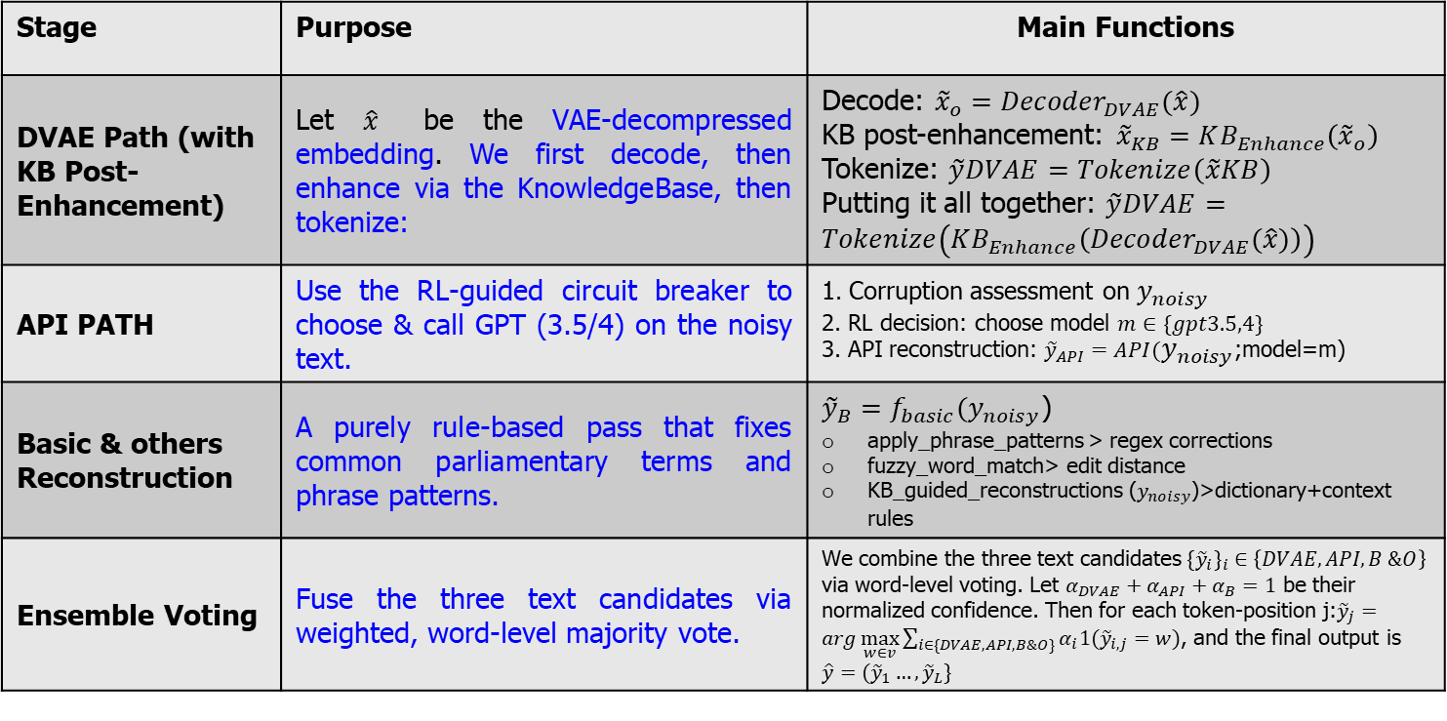
Appendix (Semantic Decoder Pipeline - 1)
The Semantic Decoder Pipeline reconstructs the original input text from the decompressed semantic embedding produced after channel decoding.
It consists of two primary decoding paths: the DVAE Path and the API Path and optionally includes Basic & others reconstruction, RL Agent Decision and Ensemble Voting mechanism to enhance robustness.
Stage | Purpose | Main Functions
DVAE Path (with KB Post-Enhancement) | Let $\hat{x}$ be the VAE-decompressed embedding. We first decode, then enhance via the KnowledgeBase, then tokenize: | Decode: ${\tilde{x}}_{o}={Decoder}_{DVAE}(\hat{x})$ KB post-enhancement: ${\tilde{x}}_{KB}=KB_{Enhance}\left({\tilde{x}}_{o}\right)$ Tokenize: $\tilde{y}DVAE=Tokenize\left(\tilde{x}KB\right)$ Putting it all together: $\tilde{y}DVAE=Tokenize\left(KB_{Enhance}\left({Decoder}_{DVAE}(\hat{x})\right)\right)$
API PATH | Use the RL‐guided circuit breaker to choose & call GPT (3.5/4) on the noisy text. | 1. Corruption assessment on $y_{noisy}$ 2. RL decision: choose model $m∈\{gpt3.5,4\}$ 3. API reconstruction: ${\tilde{y}}_{API}=API(y_{noisy}\text{;}\text{model}\text{=}\text{m}\text{)}$
Basic & others Reconstruction | A purely rule‐based pass that fixes common parliamentary terms and phrase patterns. | ${\tilde{y}}_{B}=f_{basic}(y_{noisy}$) apply_phrase_patterns​​ > regex corrections fuzzy_word_match> edit distance KB_guided_reconstructions ($y_{noisy}$)>dictionary+context rules
Ensemble Voting | Fuse the three text candidates via weighted, word-level majority vote. | We combine the three text candidates ${{\{\tilde{y}}_{i}\}}_{i}∈\left\{DVAE,API,B \&O\right\}$ via word-level voting. Let $α_{DVAE}+α_{API}+α_{B}=1$ be their normalized confidence. Then for each token-position j:${\tilde{y}}_{j}=arg\max_{w∈v}{\sum_{i∈\{DVAE,API,B\&O\}}{α_{i}1({\tilde{y}}_{i,j}=w)}}$, and the final output is $\hat{y}=({\tilde{y}}_{1}…,{\tilde{y}}_{L}\}$

Slide 36
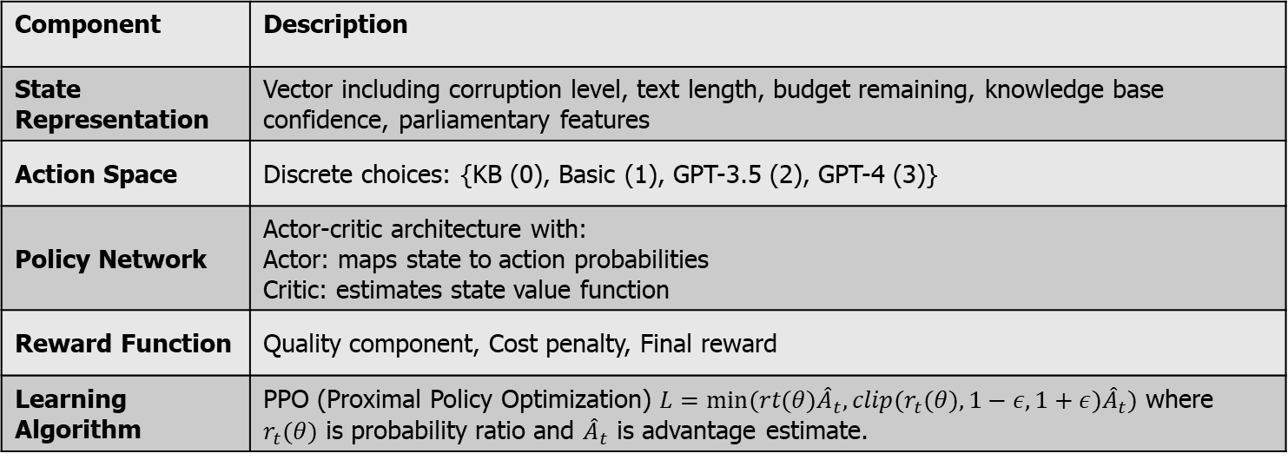
Appendix (Semantic Decoder Pipeline - 2)
API Path with RL Agent Decision
Leverage large language models (LLMs) to reconstruct text directly from noisy input, with an RL agent selecting the optimal model based on context.
Process Flow:
Corruption assessment on noisy text
RL agent decides which model to use (GPT-3.5 or GPT-4)
API call to the selected model for reconstruction
Return reconstructed text
Component | Description
State Representation | Vector including corruption level, text length, budget remaining, knowledge base confidence, parliamentary features
Action Space | Discrete choices: {KB (0), Basic (1), GPT-3.5 (2), GPT-4 (3)}
Policy Network | Actor-critic architecture with: Actor: maps state to action probabilities Critic: estimates state value function
Reward Function | Quality component, Cost penalty, Final reward
Learning Algorithm | PPO (Proximal Policy Optimization) $L=min⁡(rt​(θ){\hat{A}}_{t}​,clip(r_{t}​(θ),1−ε,1+ε){\hat{A}}_{t}​)$ where $r_{t}​(θ)$ is probability ratio and ${\hat{A}}_{t}$​ is advantage estimate.

Slide 37
Appendix (Semantic Communication Example)
Page 3
For example, if the message "The Parliament will vote tomorrow" experiences noise during transmission, a traditional system might receive it as "The Parliamemt will voto tomorrow" and leave it uncorrected. A semantic system, however, would recognize and reconstruct the intended meaning using contextual understanding and domain knowledge.

Slide 38
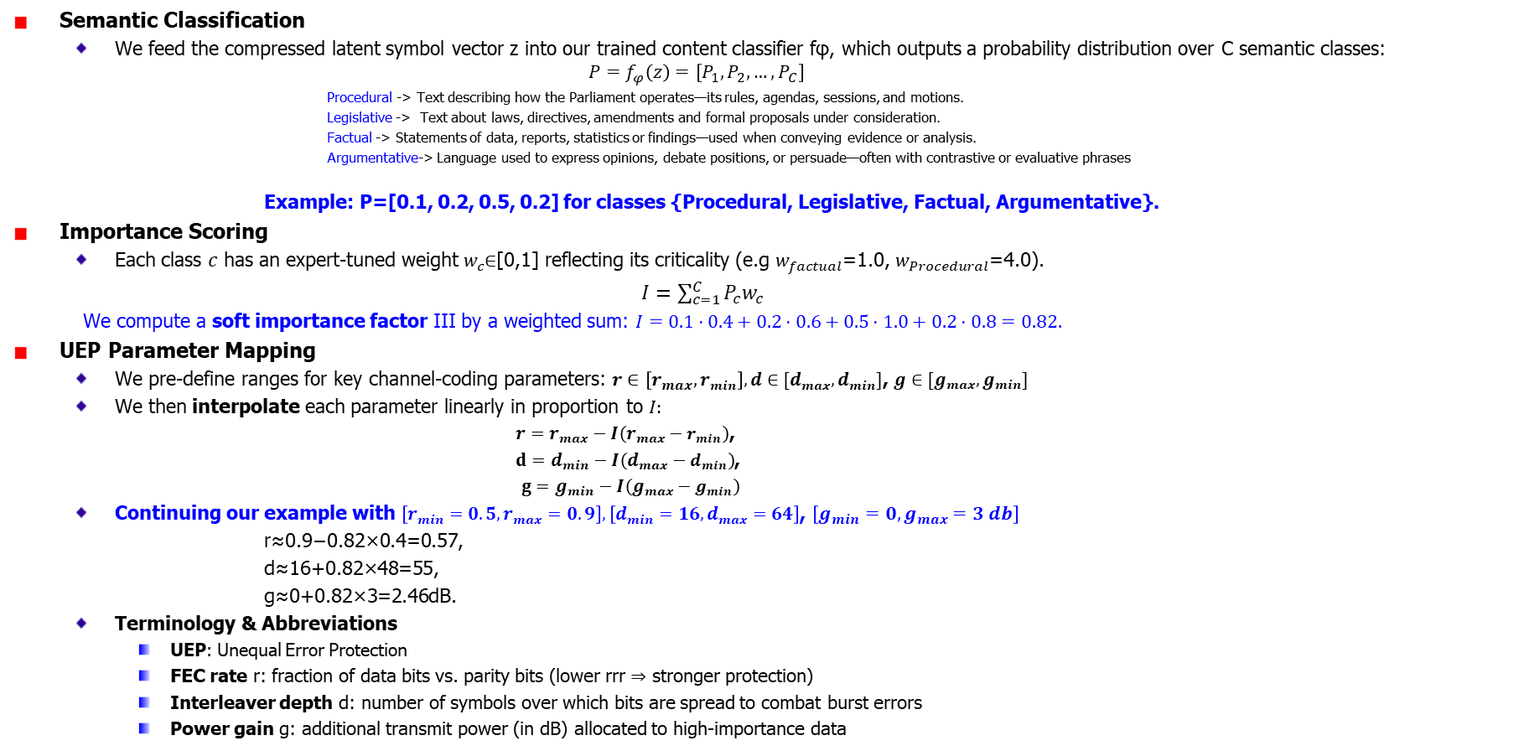
Appendix (Proposed Content-Adaptive UEP Calculation)
Semantic Classification
We feed the compressed latent symbol vector z into our trained content classifier fφ​, which outputs a probability distribution over C semantic classes:
$$P=f_{φ}\left(z\right)=\left[P_{1},P_{2},…,P_{C}\right]$$
Procedural -> Text describing how the Parliament operates—its rules, agendas, sessions, and motions.
Legislative -> Text about laws, directives, amendments and formal proposals under consideration.
Factual -> Statements of data, reports, statistics or findings—used when conveying evidence or analysis.
Argumentative-> Language used to express opinions, debate positions, or persuade—often with contrastive or evaluative phrases
Example: P=[0.1, 0.2, 0.5, 0.2] for classes {Procedural, Legislative, Factual, Argumentative}.
Importance Scoring
Each class $c$ has an expert-tuned weight $w_{c}$∈[0,1] reflecting its criticality (e.g $w_{factual}$​=1.0, $w_{Procedural}$​=4.0).
$I=\sum_{c=1}^{C}{P_{c}w_{c}}$
We compute a soft importance factor III by a weighted sum: $I=0.1⋅0.4+0.2⋅0.6+0.5⋅1.0+0.2⋅0.8=0.82.$
UEP Parameter Mapping
We pre-define ranges for key channel-coding parameters: $r∈\left[r_{max},r_{min}\right],d∈[d_{max},d_{min}]$, $g∈[g_{max},g_{min}]$
We then interpolate each parameter linearly in proportion to $I:$
$r=r_{max}−I\left(r_{max}−r_{min}\right)$,
$d=d_{min}−I\left(d_{max}−d_{min}\right)$,
$g=g_{min}−I\left(g_{max}−g_{min}\right)$
Continuing our example with $\left[r_{min}=0.5,r_{max}=0.9\right],\left[d_{min}=16,d_{max}=64\right]$, $\left[g_{min}=0,g_{max}=3 db\right]$
r≈0.9−0.82×0.4=0.57,
d≈16+0.82×48=55,
g≈0+0.82×3=2.46dB.​
Terminology & Abbreviations
UEP: Unequal Error Protection
FEC rate r: fraction of data bits vs. parity bits (lower rrr ⇒ stronger protection)
Interleaver depth d: number of symbols over which bits are spread to combat burst errors
Power gain g: additional transmit power (in dB) allocated to high-importance data

Slide 39
Appendix (Reconstruction Selection Criteria)
Page 9,32 [Reconstruction Selection Criteria (Exact Selection Thresholds)]
Knowledge Base (KB) Selection
Force KB use if: KB confidence > 0.65
Select KB if: KB quality ≥ 0.75 (for parliamentary text) or ≥ 0.7 (general text)
Basic Reconstruction Selection
Force Basic if: Budget remaining < 0.12
Select Basic if: Basic quality ≥ 0.75 (parliamentary) or ≥ 0.7 (general)
API Selection Rules
GPT-3.5 Turbo: Default API model
GPT-4 Turbo if:
Corruption level > 0.6 AND parliamentary terms AND budget > 0.5
OR corruption level > 0.7 AND budget > 0.6
Downgrade to GPT-3.5 if: Budget < 0.35
Budget Constraints
Budget < 0.3: Prefer KB (80%) or Basic (20%)
Budget < 0.12: Force Basic method only
Parliamentary Content Rules
Detected parliamentary terms: Increase quality threshold from 0.7 to 0.75
Corruption < 0.2: Limit to KB/Basic (action ≤ 1)
Corruption < 0.35: Limit to KB/Basic/GPT-3.5 (action ≤ 2)
Corruption < 0.5: At least Basic, at most GPT-3.5 (1 ≤ action ≤ 2)
Corruption > 0.5 + Budget > 0.4: At least GPT-3.5 (action ≥ 2)
Corruption > 0.7 + Budget > 0.6: Use GPT-4 (action = 3)
Exploration Rate (The exploration rate controls how often the agent tries random actions instead of following its learned policy)
Random exploration: 8% probability (0.08) [the agent will ignore quality scores and try a random action]
With good budget (> 0.6): Choose KB/Basic/GPT-3.5/GPT-4 with weights [0.3, 0.3, 0.3, 0.1]
With limited budget (≤ 0.6): Choose only KB or Basic
Example 1: Choosing GPT-4 for Important Parliamentary Content
KB reconstruction quality: 0.40
Basic reconstruction quality: 0.72
Important parliamentary term 'Rule' present, increasing quality threshold
RL agent selected GPT-4 Turbo
In this case:
Parliamentary term "Rule" was detected, raising quality threshold to 0.75
KB quality (0.40) was below threshold
Basic quality (0.72) was below the parliamentary threshold of 0.75
The system detected significant corruption with important parliamentary content
Budget was sufficient (> 0.5), so it selected GPT-4 Turbo
Example 2: Choosing KB When High Quality
KB reconstruction quality: 0.77
Basic reconstruction quality: 0.72
Important parliamentary term 'Rule' present, increasing quality threshold
RL agent selected KB reconstruction
In this case:
KB quality (0.77) exceeded the parliamentary threshold (0.75)
Basic quality (0.72) was below threshold
KB was selected as it provided the highest quality above threshold
Example 3: Budget Constraint Forces Basic
KB reconstruction quality: 0.60
Basic reconstruction quality: 0.65
Budget remaining: 0.10
RL agent selected Basic reconstruction
Here, despite both methods being below ideal quality, budget constraint (< 0.12) forces Basic reconstruction regardless of quality.
Example 4: High Corruption with Limited Budget
KB reconstruction quality: 0.40
Basic reconstruction quality: 0.50
Corruption level: 0.80 Budget remaining: 0.30
RL agent selected GPT-3.5 Turbo
In this scenario, high corruption would normally warrant GPT-4, but limited budget (< 0.35) causes a downgrade to GPT-3.5.
Notes:
Exploration Rate * Random exploration: 8% probability (0.08) * With good budget (> 0.6): Choose KB/Basic/GPT-3.5/GPT-4 with weights [0.3, 0.3, 0.3, 0.1] * With limited budget (≤ 0.6): Choose only KB or Basic
---------------------
Answer: This means:
Exploration Trigger: With 8% probability, the agent will ignore quality scores and try a random action
Budget-Based Action Selection:
When budget > 0.6 (plenty of budget remaining):
It randomly selects from all four methods with specified weights
KB (30%), Basic (30%), GPT-3.5 (30%), GPT-4 (10%)
Higher weights for less expensive options, but still allows occasional GPT-4 use
When budget ≤ 0.6 (limited budget):
It only selects between KB and Basic with equal probability (50% each)
API methods (GPT-3.5, GPT-4) are excluded completely to conserve budget
Example in Action
if random.random() < 0.08:
if budget_remaining > 0.6:
forced_action = random.choices([0, 1, 2, 3], weights=[0.3, 0.3, 0.3, 0.1])[0]
else:
forced_action = random.choice([0, 1]) # Only explore KB and Basic when budget limited
logger.debug(f"Forcing exploration with action {forced_action}")
return forced_action, 0.0
Here's what exploration would look like in your logs:
Random number: 0.05 (< 0.08, triggering exploration) Budget remaining: 0.75 (> 0.6, using all methods) Exploration selects: Action 2 (GPT-3.5) based on weights [0.3, 0.3, 0.3, 0.1] Log: "Forcing exploration with action 2"
Or with limited budget:
Random number: 0.03 (< 0.08, triggering exploration) Budget remaining: 0.45 (≤ 0.6, restricting to KB/Basic) Exploration selects: Action 0 (KB) with 50% probability Log: "Forcing exploration with action 0"
This exploration mechanism ensures the agent:
Continues to try different methods occasionally
Becomes more conservative with budget use as resources diminish
Maintains a balance between exploring new strategies and exploiting known good ones
The 8% probability gradually decreases over time as the agent learns better strategies, dropping to a minimum of 5% (indicated by the line self.epsilon = max(0.05, self.epsilon * 0.995) in your code).

Slide 40
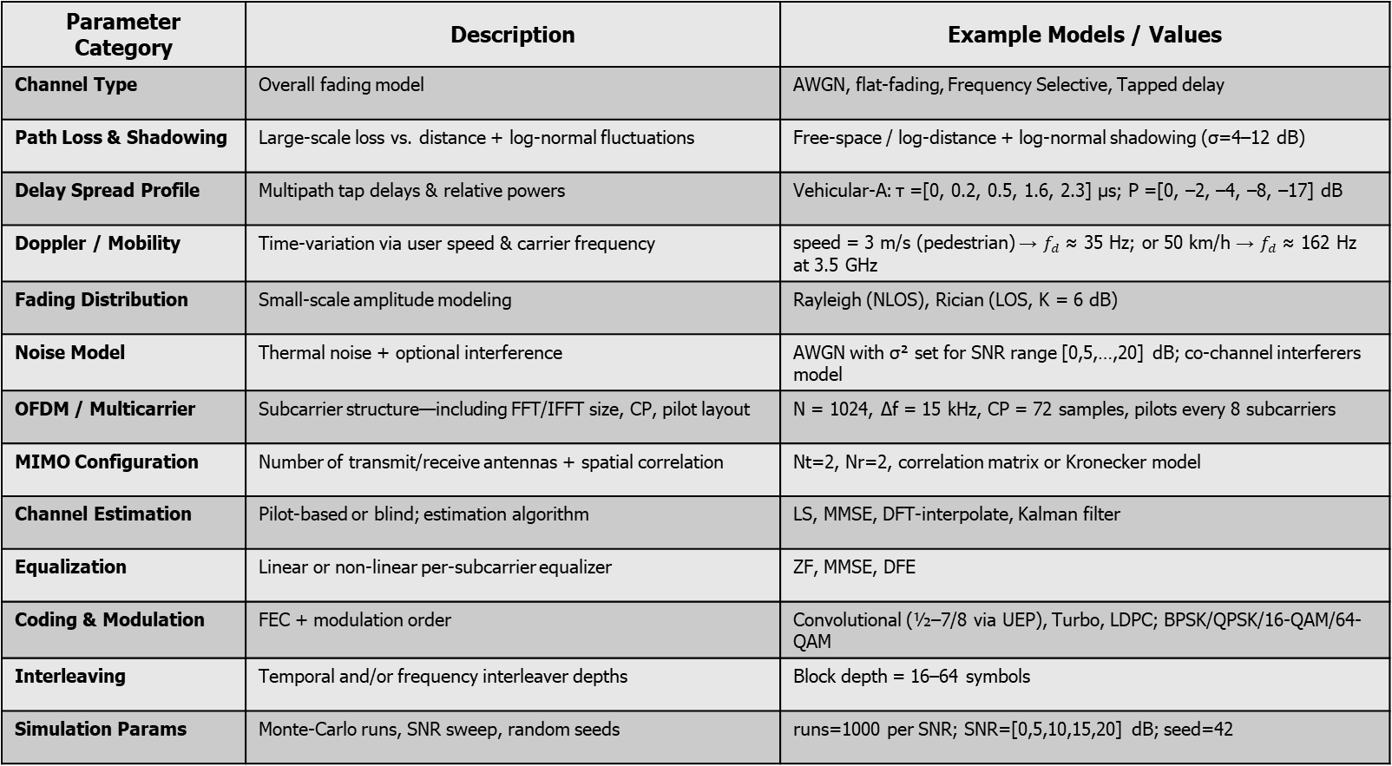
Appendix (Physical Channel Environment parameter)
Parameter Category | Description | Example Models / Values
Channel Type | Overall fading model | AWGN, flat-fading, Frequency Selective, Tapped delay
Path Loss & Shadowing | Large‐scale loss vs. distance + log‐normal fluctuations | Free‐space / log‐distance + log‐normal shadowing (σ=4–12 dB)
Delay Spread Profile | Multipath tap delays & relative powers | Vehicular-A: τ =[0, 0.2, 0.5, 1.6, 2.3] µs; P =[0, –2, –4, –8, –17] dB
Doppler / Mobility | Time‐variation via user speed & carrier frequency | speed = 3 m/s (pedestrian) → $f_{d}$ ≈ 35 Hz; or 50 km/h → $f_{d}$ ≈ 162 Hz at 3.5 GHz
Fading Distribution | Small‐scale amplitude modeling | Rayleigh (NLOS), Rician (LOS, K = 6 dB)
Noise Model | Thermal noise + optional interference | AWGN with σ² set for SNR range [0,5,…,20] dB; co-channel interferers model
OFDM / Multicarrier | Subcarrier structure—including FFT/IFFT size, CP, pilot layout | N = 1024, Δf = 15 kHz, CP = 72 samples, pilots every 8 subcarriers
MIMO Configuration | Number of transmit/receive antennas + spatial correlation | Nt=2, Nr=2, correlation matrix or Kronecker model
Channel Estimation | Pilot‐based or blind; estimation algorithm | LS, MMSE, DFT‐interpolate, Kalman filter
Equalization | Linear or non‐linear per‐subcarrier equalizer | ZF, MMSE, DFE
Coding & Modulation | FEC + modulation order | Convolutional (½–7/8 via UEP), Turbo, LDPC; BPSK/QPSK/16-QAM/64-QAM
Interleaving | Temporal and/or frequency interleaver depths | Block depth = 16–64 symbols
Simulation Params | Monte-Carlo runs, SNR sweep, random seeds | runs=1000 per SNR; SNR=[0,5,10,15,20] dB; seed=42

